Slide 1


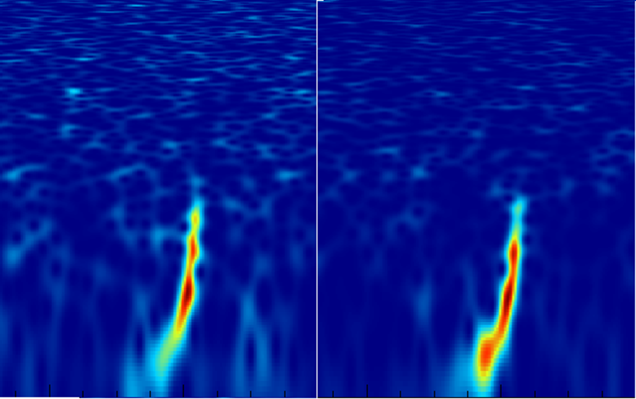



Overview of observations of Gravitational Waves by LIGO and Virgo
Giovanni Andrea Prodi
Virgo Group at Padova-Trento,
LIGO Scientific Collaboration and Virgo Collaboration
Workshop Flag meeting The Quantum and Gravity , Povo, June 6, 2016

Slide 2
Published Discoveries
Detection of a propagating Gravitational Wave
Direct observation of a stellar-mass Black Hole binary → merger
The most luminous astrophysical event detected
plus
test of General Relativity in strong field & highly relativistic regime
...
The Dawn of novel Explorations
Astronomy & Astrophysics ... distance scale, BH & NS formation, GRBs...
Fundamental Physics
  → space-time and extended theories of gravity
  → event horizons of Black Holes
  → equations of state of Neutron Stars

Slide 3

Outline
first Observation Run by the Advanced LIGO detectors
GW150914 properties
tests on GR consistency
extending the network of gravitational wave detectors
outlook

Slide 4
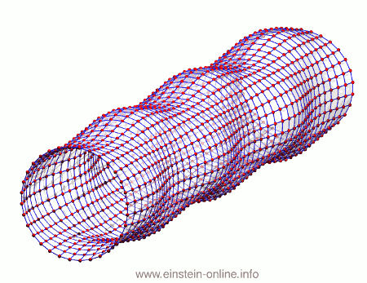
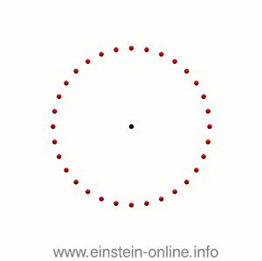



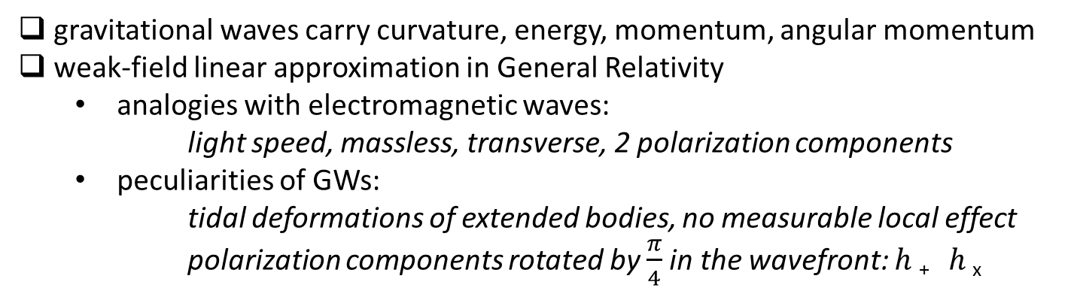
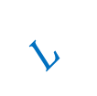

Gravitational Waves far away from sources
gravitational waves carry curvature, energy, momentum, angular momentum
weak-field linear approximation in General Relativity
  analogies with electromagnetic waves:
      light speed, massless, transverse, 2 polarization components
  peculiarities of GWs:
      tidal deformations of extended bodies, no measurable local effect
      polarization components rotated by $\frac{π}{4}$in the wavefront: $h$₊ $h$_{x}
Effect on free
test masses:
in wavefront plane:
GW amplitude is
strain:
$$h_{+}$$
$L$
$$h=\frac{ΔL}{L}$$
λ_{GW}
$L$
$$h_{×}$$

Slide 5
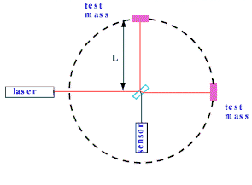
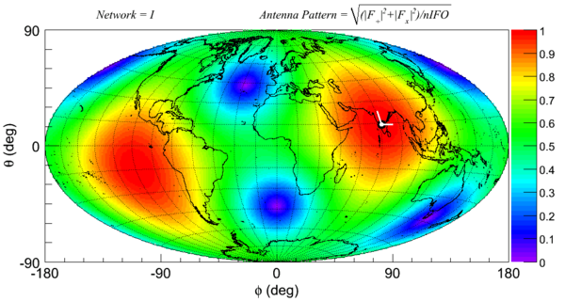
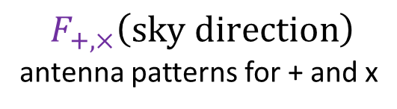
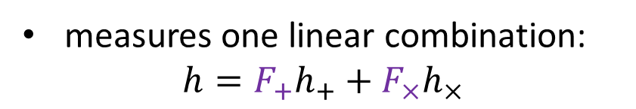
directional sensitivity of detectors
Each interferometer senses one of the two polarizations of GWs
measures one linear combination:
$$h=F_{+}h_{+}+F_{×}h_{×}$$
$$F_{+,×}\left(sky direction\right)$$
antenna patterns for + and x
misses the orthogonal combination of GW polarizations.
directional sensitivity to the optimal polarization component is broad:

Slide 6


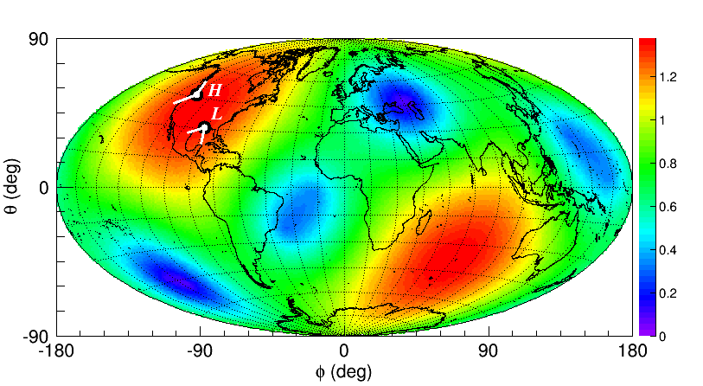
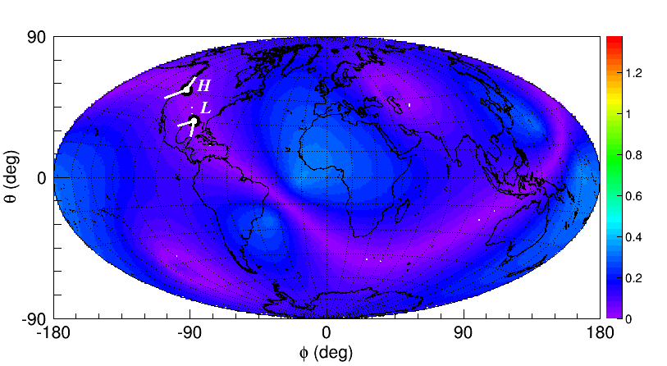
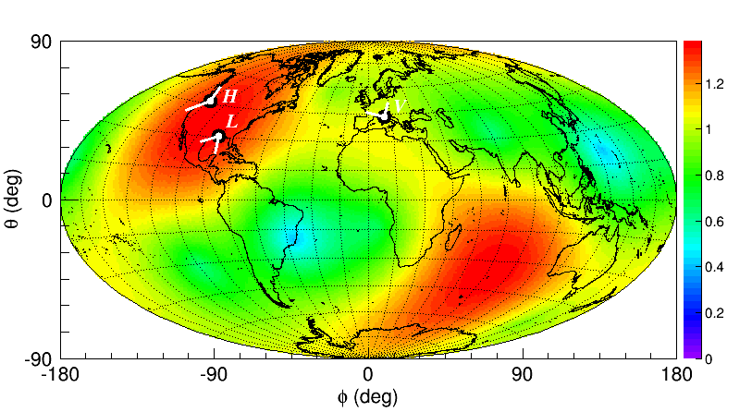
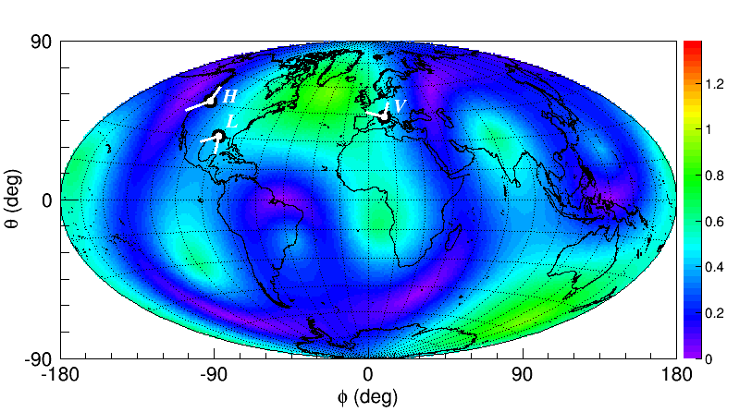
Benefits of a 3 detectors network
Detection confidence is greatly improved: lower background and higher SNR
Better coverage of sky and GW polarizations: better waveform reconstruction
LIGO H1+LIGO L1
LIGO H1+LIGO L1+ Virgo

Slide 7
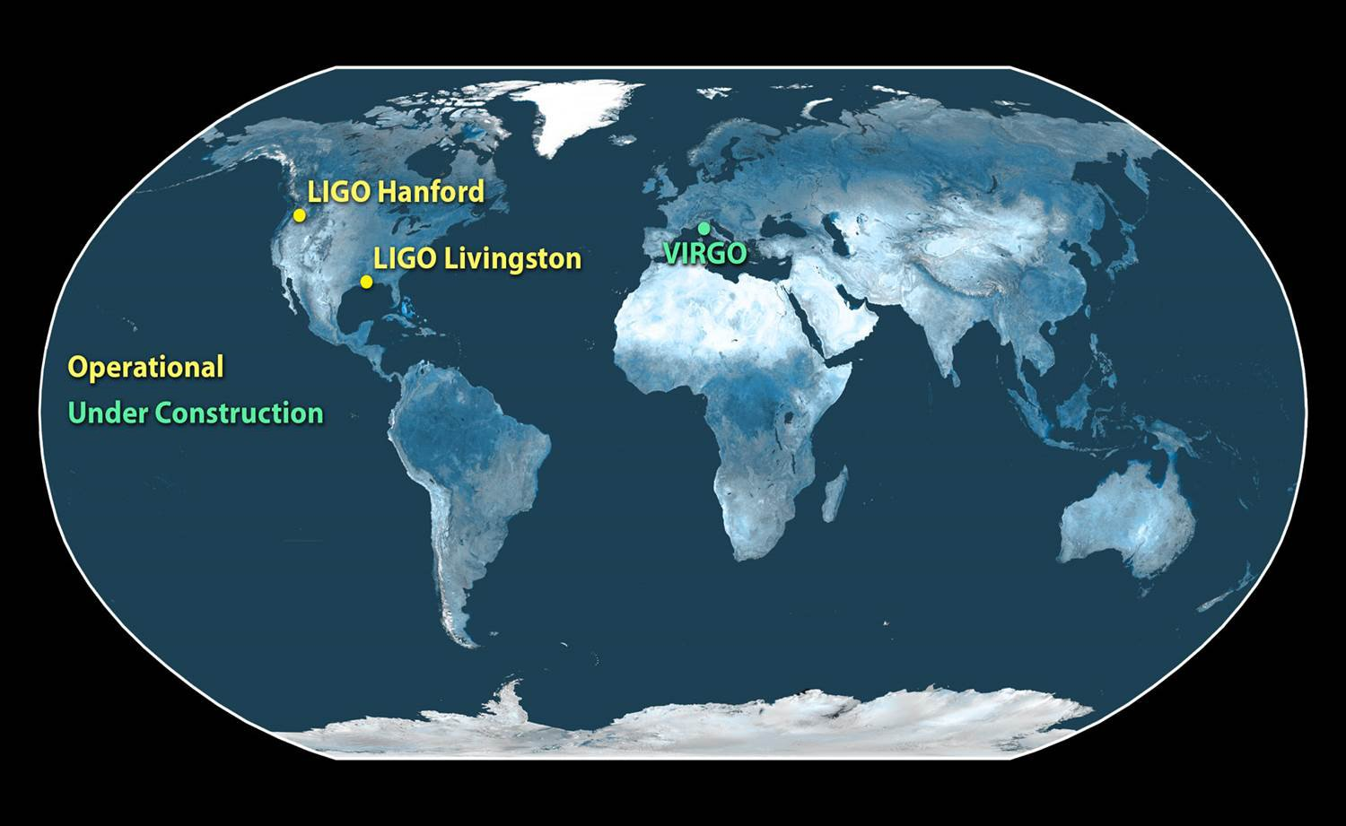
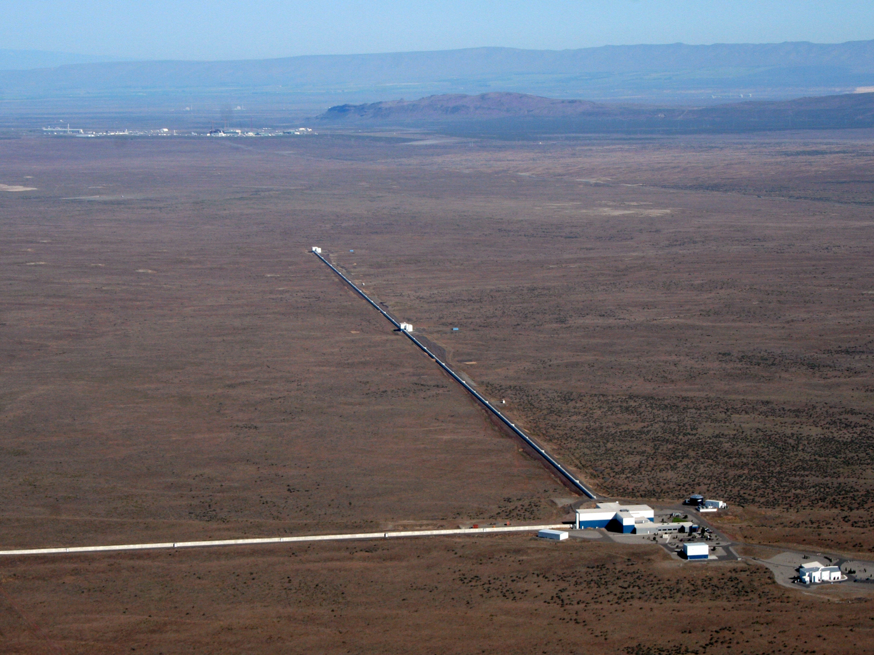
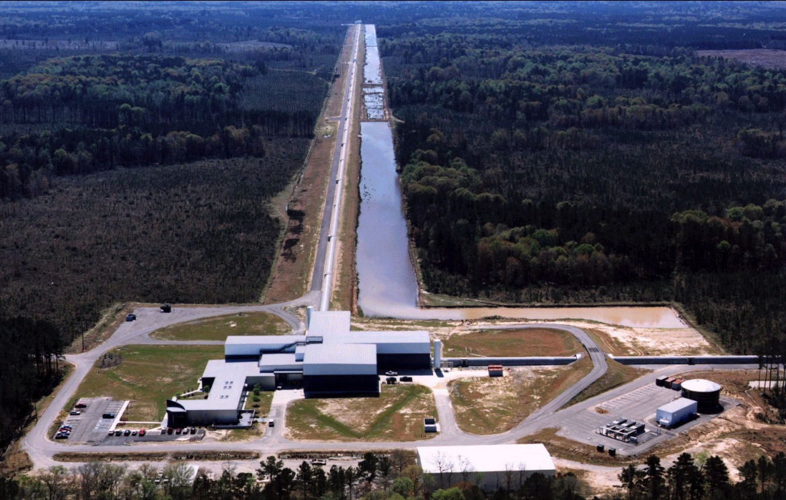
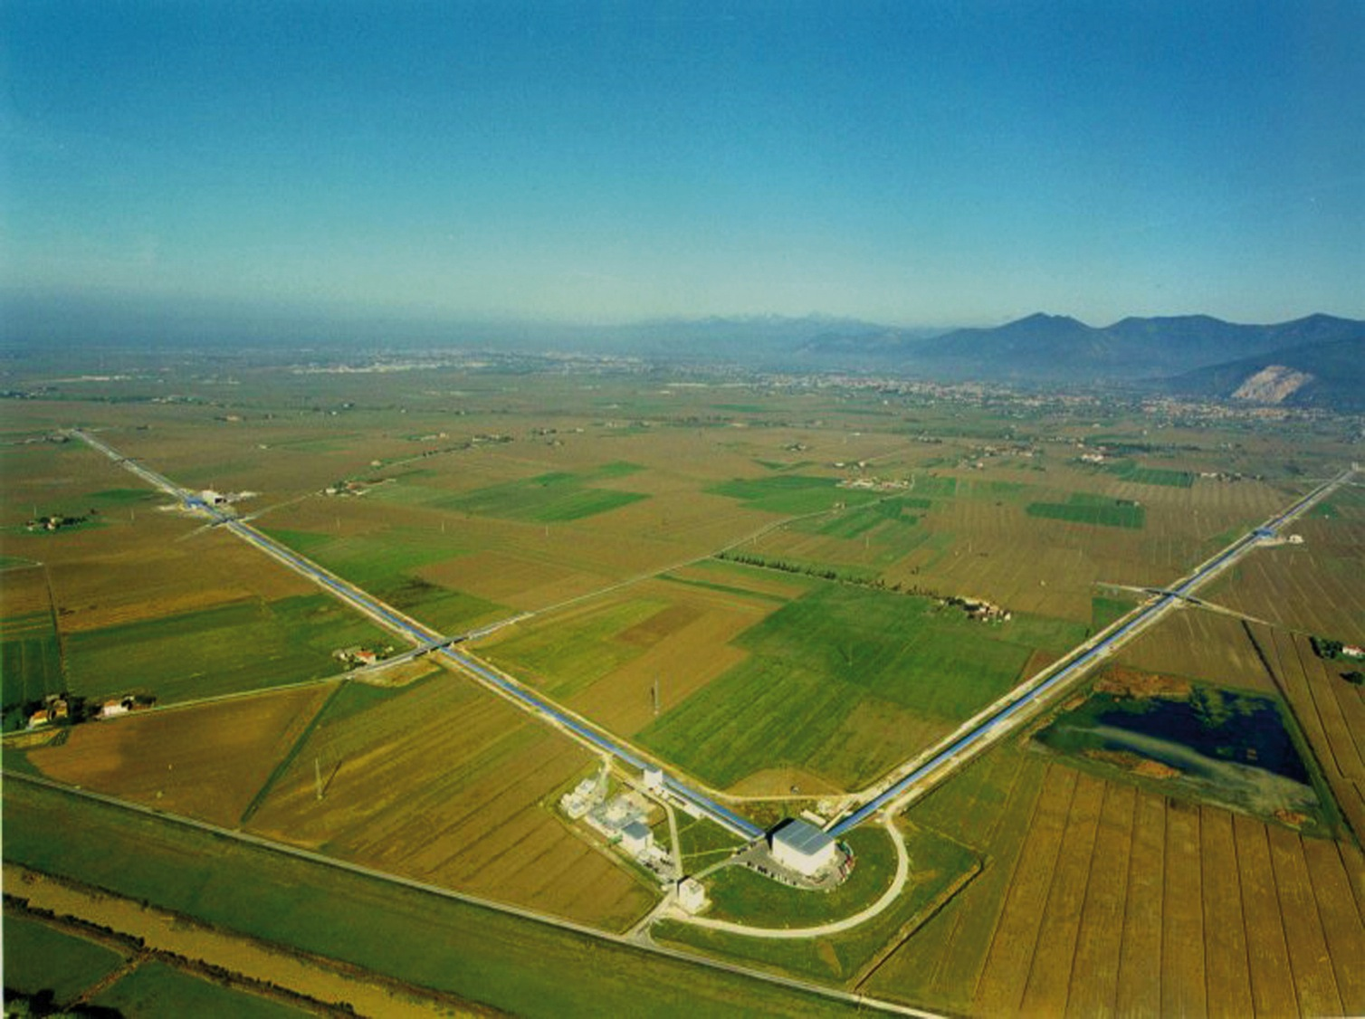
The LIGOs and Virgo long-arm detectors
HANFORD
LIVINGSTON
VIRGO

Slide 8
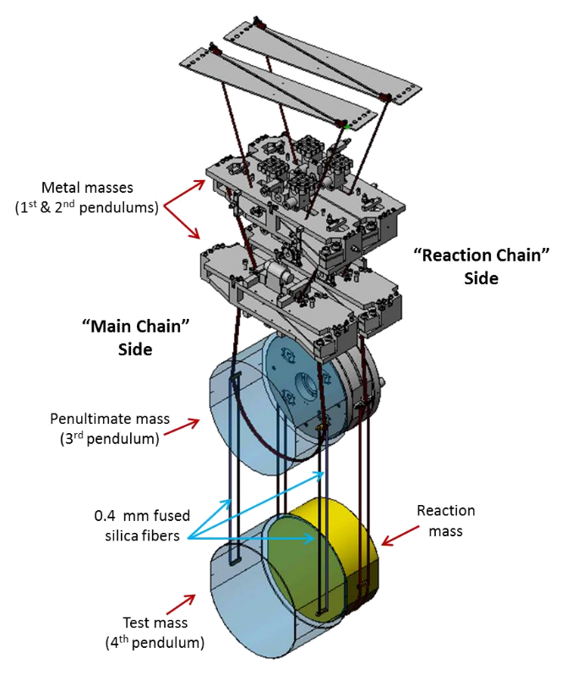
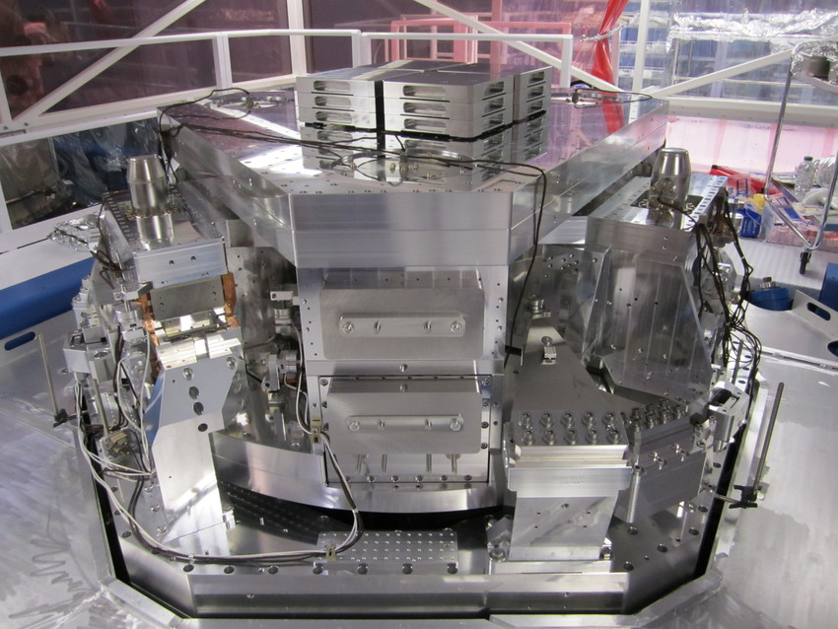
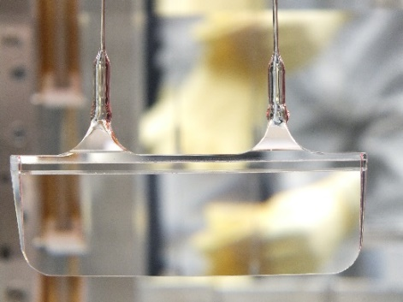
Advanced LIGO upgrades: suspensions
seismic noise reduction (>10¹⁰ above 10 Hz)
first stage active suspension
last stage passive suspension
Monolitic suspension thermal noise reduction

Slide 9
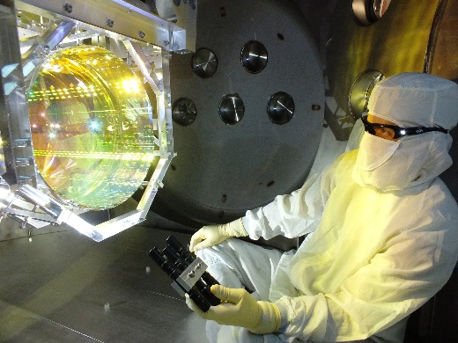
Advanced LIGO upgrades
Thermal & radiation pressure
noise reduction
Larger mass mirrors, improved coatings
Photon shot
noise reduction
4 km long optical resonators, optical gain ≈ 300
100 kW circulating laser power (design target is 750 kW)
20 W input laser (up to 180 W available), 1 Hz line-width
Signal recycling

Slide 10
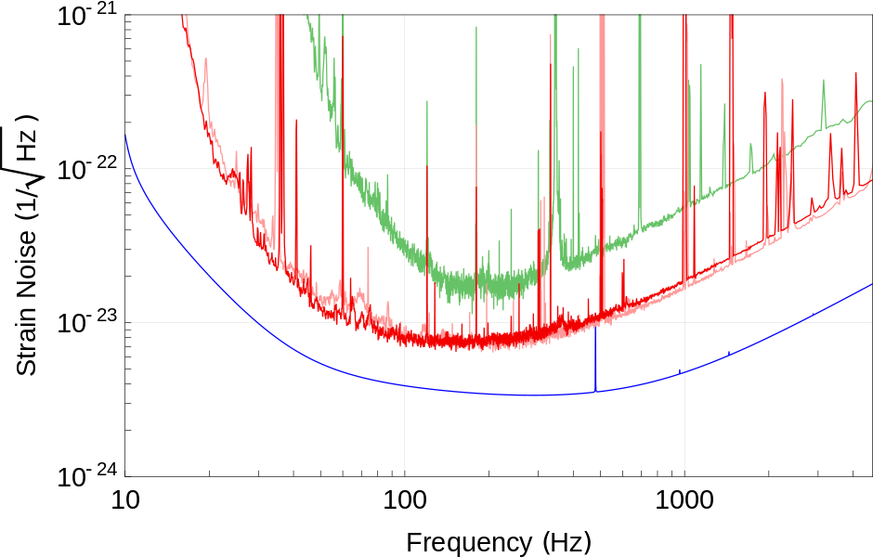
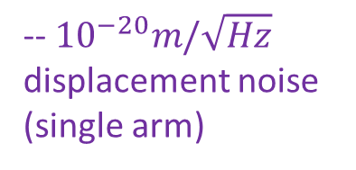
Spectral sensitivity of Advanced LIGO detectors
--LIGO S6 run (2010)
--Advanced LIGO O1
run (2015)
--Advanced LIGO
design goal
-- ${10}^{−20}m/\sqrt{Hz}$
displacement noise
(single arm)
measured frequency range of GW150914
    observations 2015 vs 2010:
    averaged observable volume of Universe : ∼100x gain for BBH like GW150914
    ∼30x gain for BNS coalescence events
    first 16days of 2015 joint observation exceed detection potential of all previous observations

Slide 11
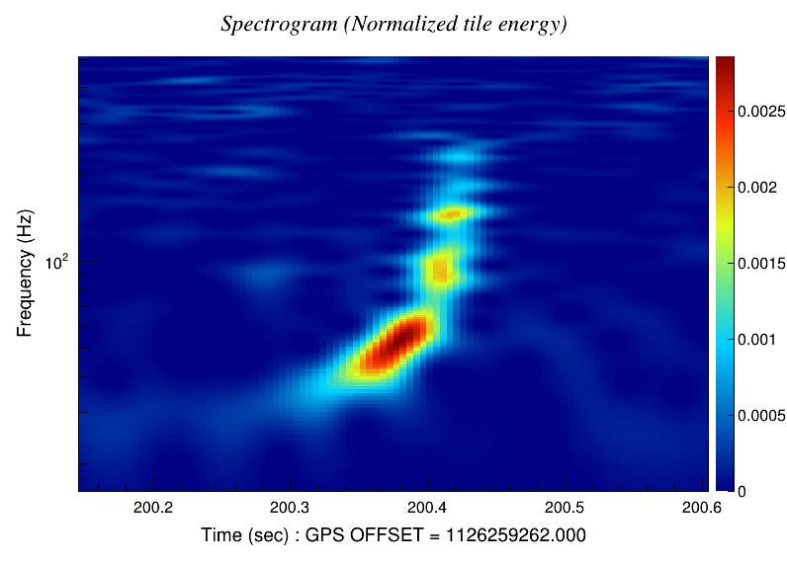
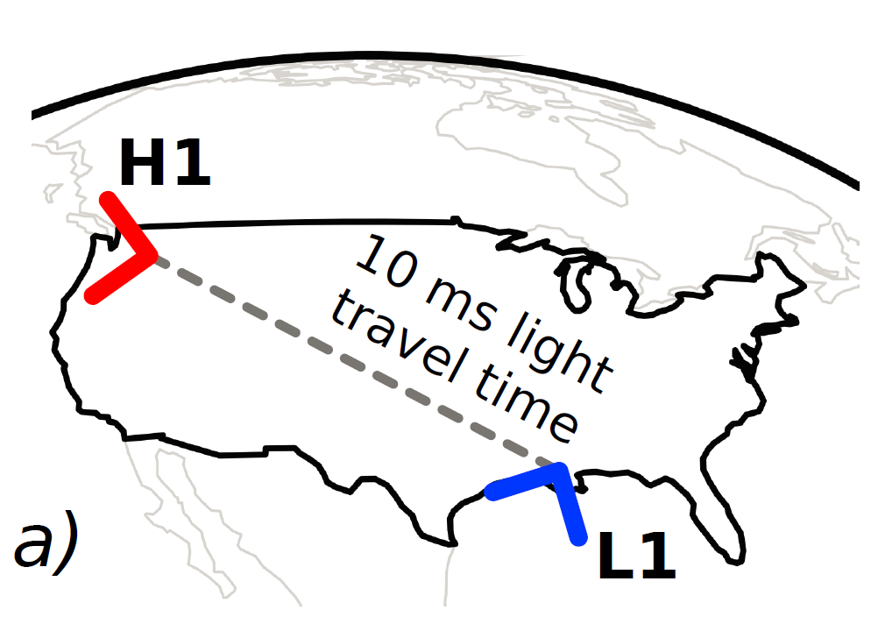
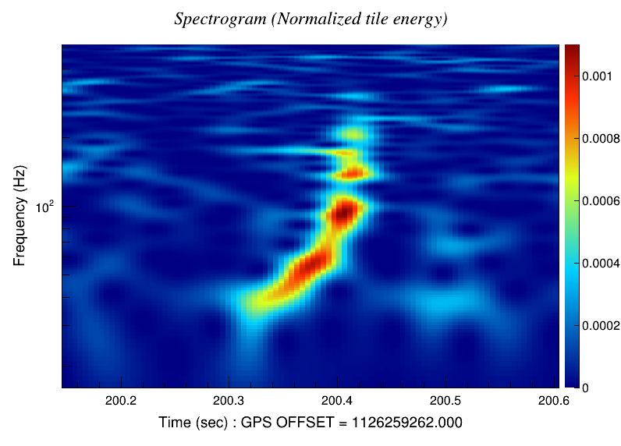
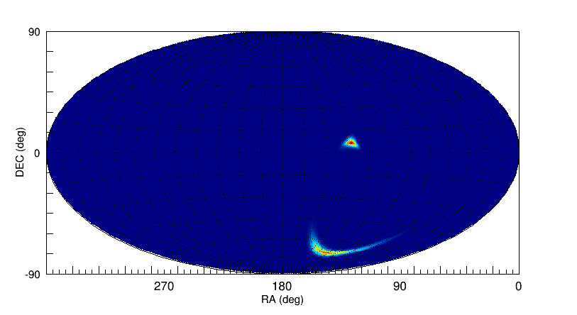
GW150914 chronology
Last days of LIGO Engineering Run before planned Science Run
Delay time 7 ms
Sept. 14, 2015 UTC: 09:50:45
+ 3 minutes:
  rapid alert from our low latency detection pipeline (coherent Wave Burst: Florida, Hannover, Padova-Trento)
sky localization map
+ 17 minutes:
  first sky map (cWB), 600 deg² @ 90% c.l.
+ 4 hours / next days:
  confirmations by other data analysis pipelines

Slide 12
GW150914 observation run
prompt switch from Engineering Run to Science Mode Operation
  priority to stable operation of LIGO detectors
  start of cross checks: detection check-list
next calendar day:
  alert sent via GCN circular to 62 partner astronomers (including INAF)
  target latency in science mode would have been < 1 hour
week timescale:
  started internal LIGO-Virgo procedure for validation of GW detection
  end to end detection validation was previously tested in 2010 (blind injection challenge)
decision to continue observing in stable detector configuration until LIGO detectors integrate at least 15 days of joint observation time
  Sept. 12th – Oct. 20th
  Resulting joint observation time 17 days
  Duty cycle: H1 70%, L1 55%, joint time 50%

Slide 13
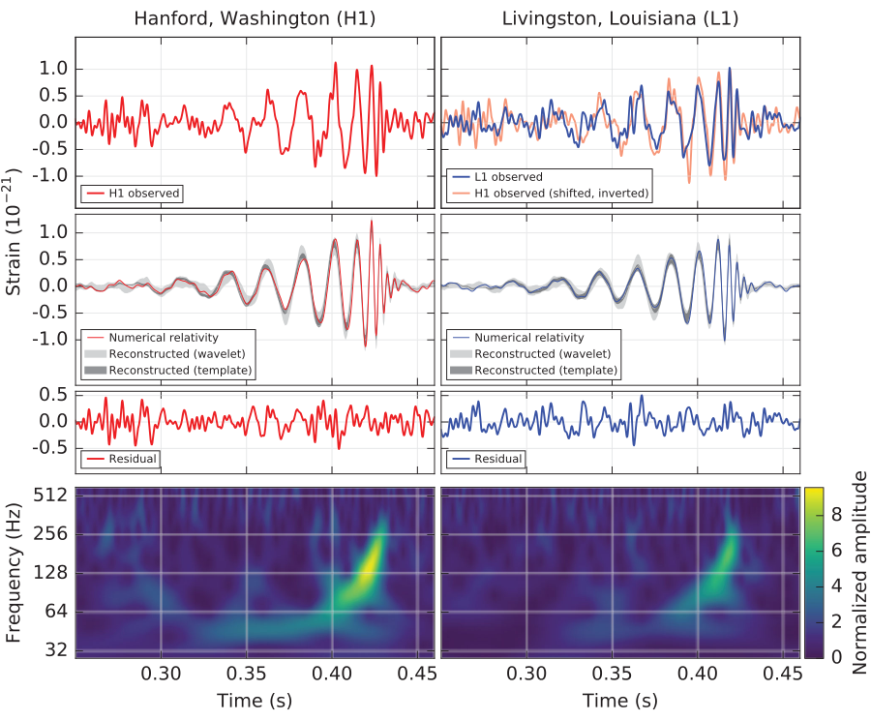

GW150914
$${10}^{−18 }m$$
Phys. Rev. Lett. 116, 061102

Slide 14
GW150914 confidence level
ruled out environmental influences and non-Gaussian instrument noise at either LIGO detector for GW150914 [arXiv: 1602.03844, CQG in press]
two independent data analysis methods used to estimate the confidence:
Search for GW transients of general waveforms,
    coherent responses in distant detectors using minimal assumptions,
    the more general discovery tools
Search for GW transients from compact binary coalescences
    matched filtering methods
Estimated False Alarm Rate of GW150914:
< 1 / 22500 years in wider context of generic transient signals
< 1 / 203000 years within compact binary coalescence signals

Slide 15
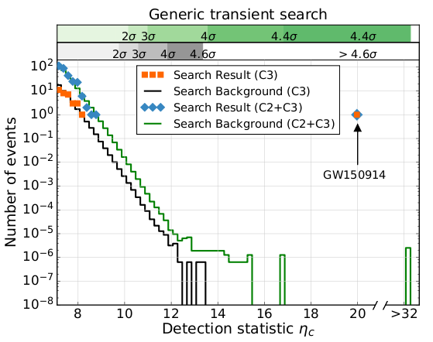
GW150914 confidence, general transient signals
Coherent WaveBurst pipeline has been the reference for generic transients:
Search parameter space divided into 3 classes of different signal morphologies
GW150914 is the strongest event of the search
67400 years of equivalent off-source data
C1
inspired to known
noise transients
C3
frequency increasing with time
C2
others
trial factor =3
transient noise events as strong as or stronger than GW150914 have
rate < 1 in 22500 years
false alarm probability < 2ˑ10⁻⁶ during the analyzed time

Slide 16
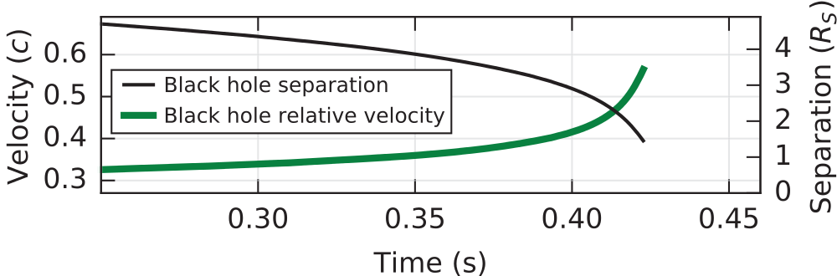
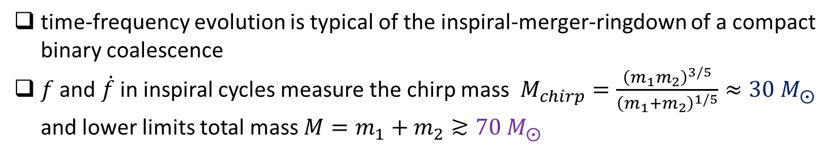
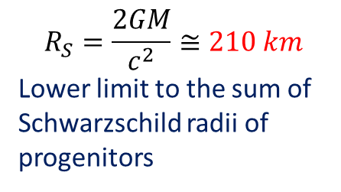
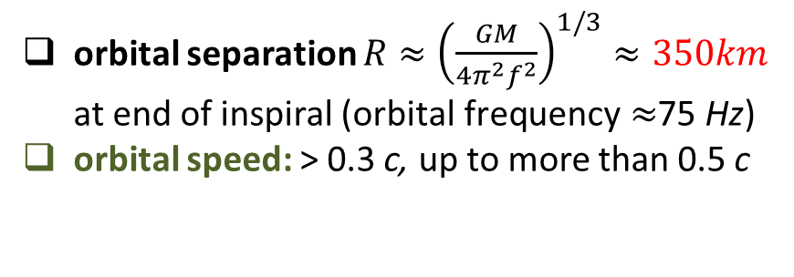
GW150914: inspiral
time-frequency evolution is typical of the inspiral-merger-ringdown of a compact binary coalescence
$f$ and $\dot{f}$ in inspiral cycles measure the chirp mass $M_{chirp}=\frac{{\left(m_{1}m_{2}\right)}^{3/5}}{{\left(m_{1}+m_{2}\right)}^{1/5}}≈30 M_{⨀}$
and lower limits total mass $M=m_{1}+m_{2}≳70{ M}_{⨀}$
$$R_{S}=\frac{2GM}{c^{2}}≅210 km$$
Lower limit to the sum of Schwarzschild radii of progenitors
Newtonian approximations for:
orbital separation ${R≈\left(\frac{GM}{4π^{2}f^{2}}\right)}^{1/3}≈350km$ at end of inspiral ($\text{orbital} \text{frequency}≈$75 Hz)
orbital speed: > 0.3 c, up to more than 0.5 c
Black Holes progenitors are the only known compact objects in the given mass range that can orbit up to frequency ≈ 75Hz before collision
Phys. Rev. Lett. 116, 061102

Slide 17
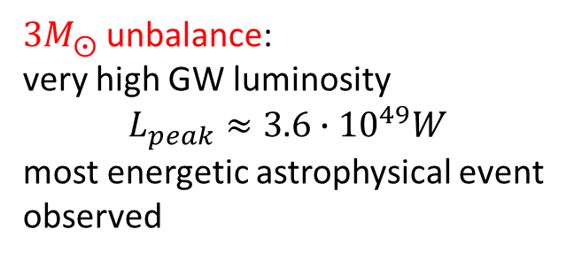
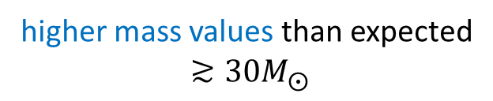
GW150914 parameters [arXiv:1602.03840]
Parameter Estimation is achieved by Bayesian model selection over a template bank of analytical waveforms calibrated against numerical relativity simulations of the merger
17 dimensions parameter space: 2 masses, 2x3 spin, distance, 2 sky coordinates, 4 orbital parameters, time and phase of coalescence.
15 parameters investigated (assumption of circular orbits0
higher mass values than expected
$$≳30M_{⨀}$$
$3M_{⨀}$unbalance:
very high GW luminosity
$$L_{peak}≈3.6∙{10}^{49}W$$
most energetic astrophysical event observed
high uncertainty: degeneracy between distance and inclination angle to the source, since the LIGOs are sensitive to only one polarization of the GW

Slide 18
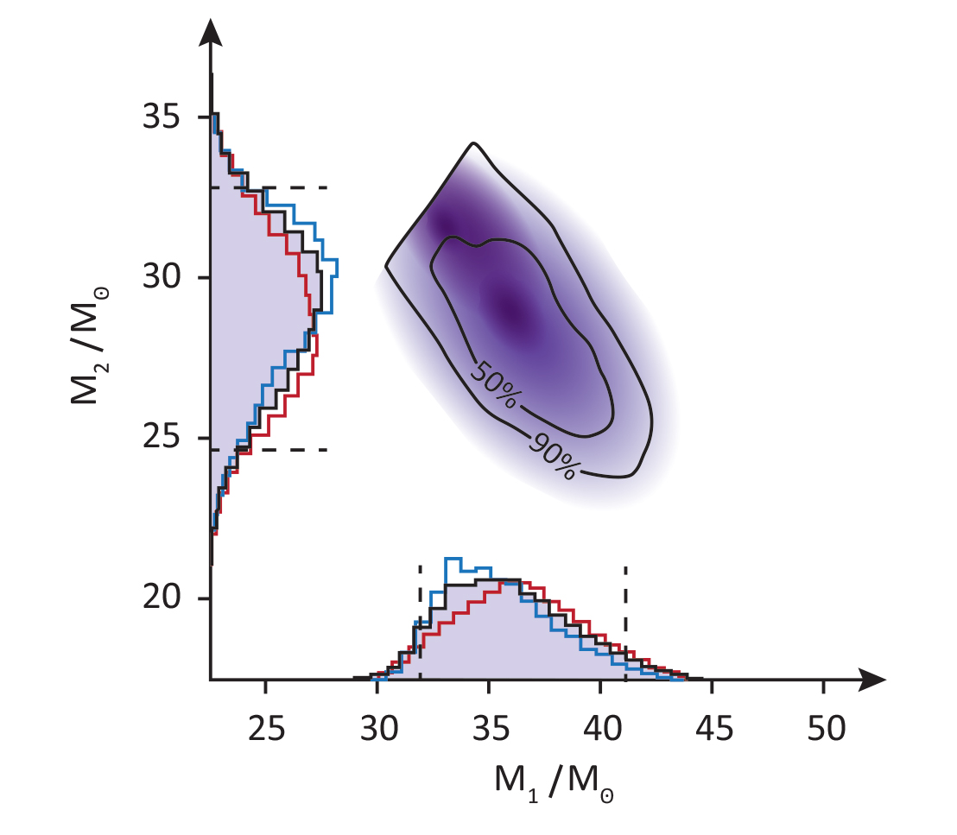
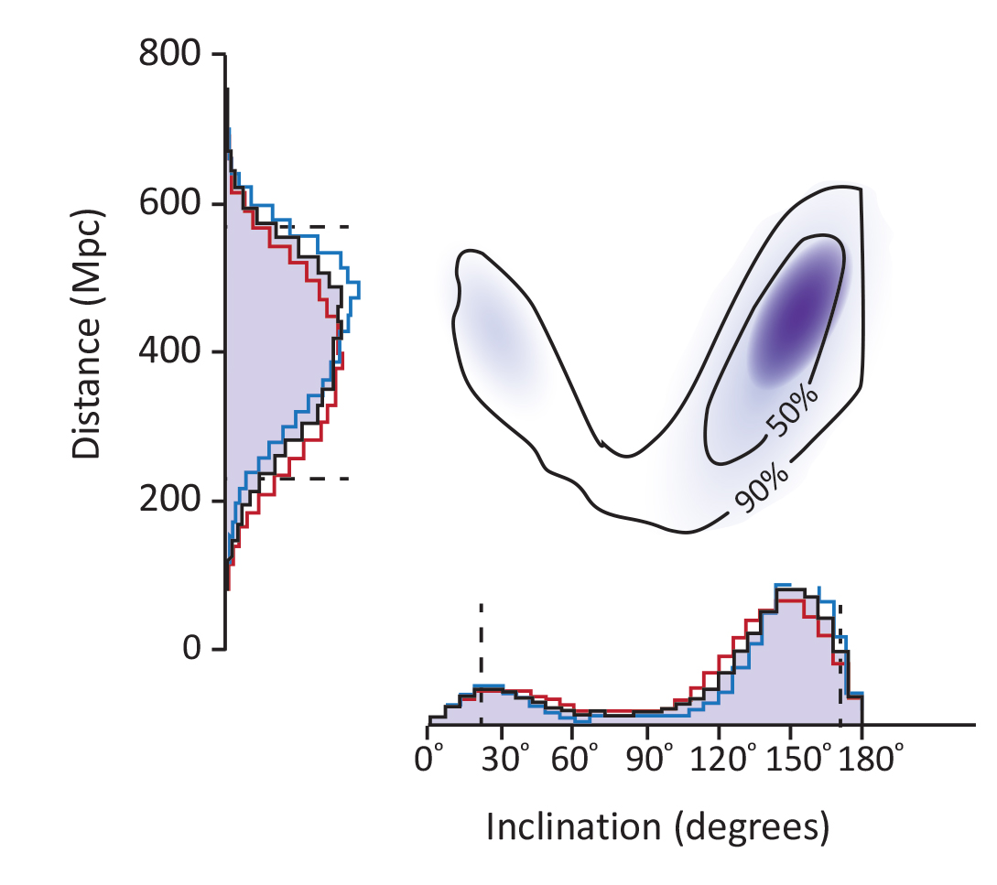
GW150914 parameters [arXiv:1602.03840]
no cosmological red shift measurement is possible from GWs alone, since a frequency rescaling is indistinguishable from a mass rescaling

Slide 19
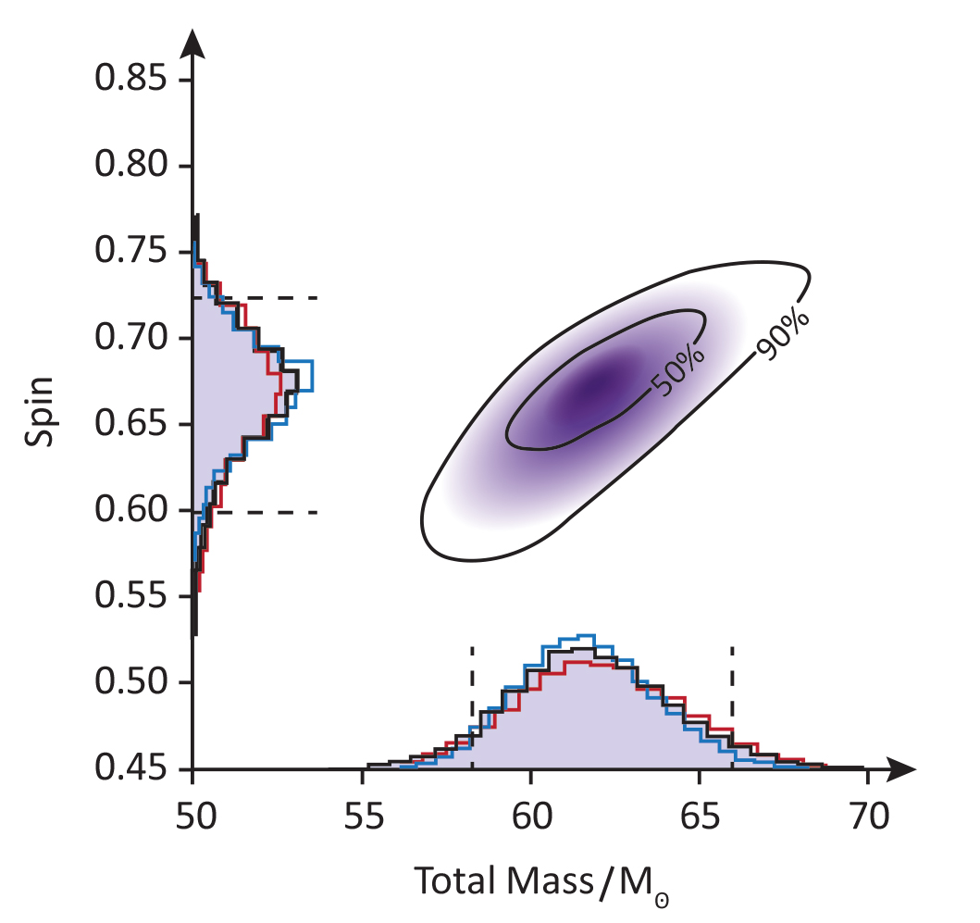
GW150914 parameters [arXiv:1602.03840]
Remnant BH mass and spin
Embedded intrinsically in waveform model (fitting to
Waveform calibrated to Numerical Relativity)

Slide 20
Consistency with GR Black Hole solution [arXiv:1602.03841]
Parametrized waveform models calibrated to Numerical Relativity simulations. Two methods:
EOBNR: Effective One Body analytical solutions calibrated to Numerical Relativity simulations for the highest order Post Newtonian terms
IMRPhenom: phenomenological waveforms from hybridization of EOB (inspiral) with NR (merger, ringdown)
Systematic uncertainties << statistical uncertanties at SNR ∼ 25
Testing for deviations from GR waveform not degenerate with changes of parameters of the binary.
Leftover residuals of GW150914 by subtracting contributions of the best waveform are not statistically distinguishable
from instrumental noise.
95% credible upper bound on network coherent SNR in the residuals is ∼ 7.3:
Fitting Factor of best waveform model to the data > 96%
< 4% deviations from GR in terms of noise-weighted correlation

Slide 21
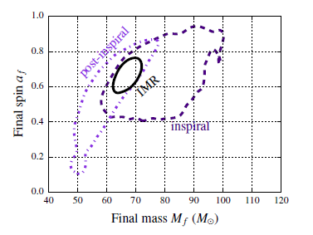
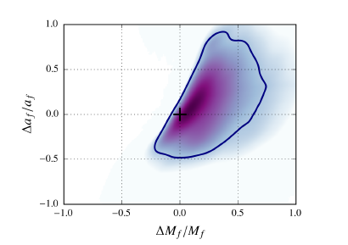
Consistency with GR Black Hole solution [arXiv:1602.03841]
Mass and spin of the remnant BH are predicted using separately inspiral phase and post-inspiral phase. Similar to a goodness of fit test.
No evidence of inconsistencies.
Fractional difference between inspiral and post-ispiral estimates
90% credible regions of Inspiral and post-inspiral joint posterior estimates show an overlap.
sanity check: estimates from entire waveform IMR lies in overlap region
- 90% contour

Slide 22
Consistency with GR Black Hole solution [arXiv:1602.03841]
Least damped Quasi Normal Mode of remnant BH: fundamental quadrupolar 2,2,0
NR with GW150914 parameters gives frequency and damping time:
this mode should dominate
ring-down phase ∼ 3 ms ∼ 10 M
after merger time
90% credible regions of parameters of a fit to damped sinusoid starting after 1 ms, 3 ms, , 5 ms from merger
weak direct evidence for this QNM in GW150914
Need to directly measure at least 2 QNMs to test no-hair theorem and 2nd law of BH dynamics

Slide 23
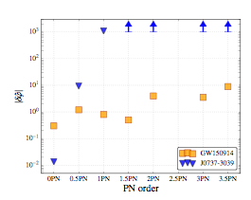
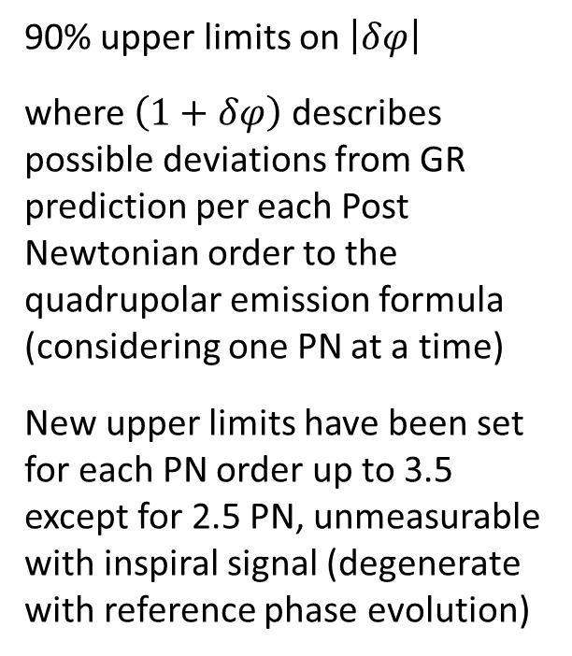
Testing GR beyond quadrupolar formula [arXiv:1602.03841]
First test of GR in strong field and highly relativistic speed
by checking the phase evolution of the inspiral signal of GW150914
90% upper limits on $\left|δφ\right|$
where $\left(1+δφ\right)$ describes possible deviations from GR prediction per each Post Newtonian order to the quadrupolar emission formula (considering one PN at a time)
New upper limits have been set for each PN order up to 3.5 except for 2.5 PN, unmeasurable with inspiral signal (degenerate with reference phase evolution)
0 PN
Quadrupolar
formula
10 years of double pulsar J0737-3039
v/c ∼ 2 10⁻³ , GM/rc² ∼ 5 10⁻⁶
Improvements expected from lower mass
BBH detections (longer duration inspiral in bandwidth)

Slide 24




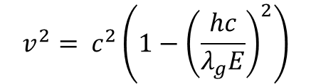
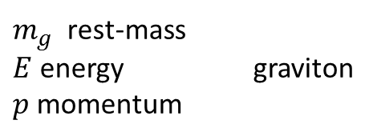
Bounds for dispersion relation of GWs [arXiv:1602.03841]
Assuming a phenomenological dispersion relation
frequency dependent graviton speed
1 PN effect on GW phase evolution, ∝ Distance
$m_{g}^{}$ rest-mass
$E$ energy graviton
$p$ momentum
$$E^{2}= p^{2}c^{2}+ m_{g}^{2}c^{4}$$
$$v^{2}= c^{2}\left(1−{\left(\frac{hc}{λ_{g}E}\right)}^{2}\right)$$
$λ_{g}≡\frac{h}{m_{g}c}$Compton wavelength
90% bound from GW150914 is the best direct bound:
$$λ_{g}>1.6 {10}^{13} km$$
$$m_{g}<1.2 {10}^{−22} eV/c^{2}$$
All other more stringent bounds to date are models/assumptions dependent (e.g. weak gravitational lensing relies on dark matter distribution …)

Slide 25
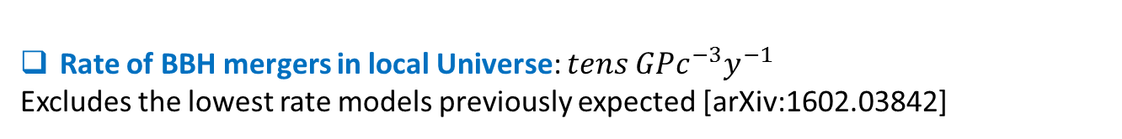
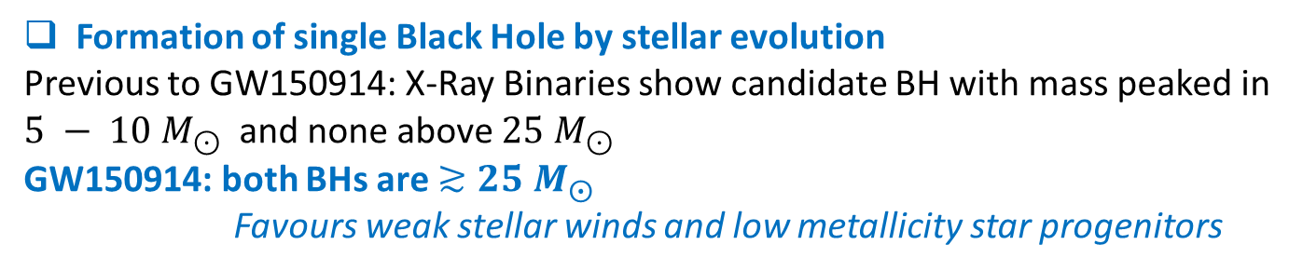
Astrophysical implications [arXiv:1602.03840]
Formation of single Black Hole by stellar evolution
Previous to GW150914: X-Ray Binaries show candidate BH with mass peaked in $5 − 10 M_{⊙}$ and none above ${25 M}_{⊙}$
GW150914: both BHs are $≳25 M_{⨀}$
      Favours weak stellar winds and low metallicity star progenitors
First binary Black Hole evidence
Binary BHs are formed close enough to merge within the Universe lifetime
mainly 2 possibilities for BBH formation
not discriminated by GW150914
As evolution of isolated binary systems
As result of dynamical interaction in dense stellar environments
Expected aligned spins with orbital angular momentum
Expected non correlated spins of BH pairs: misalignment is likely
Rate of BBH mergers in local Universe: $tens GPc^{−3}y^{−1}$
Excludes the lowest rate models previously expected [arXiv:1602.03842]

Slide 26
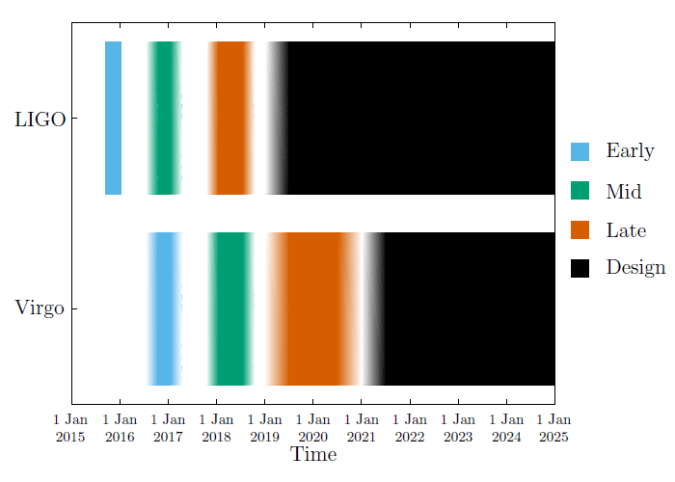
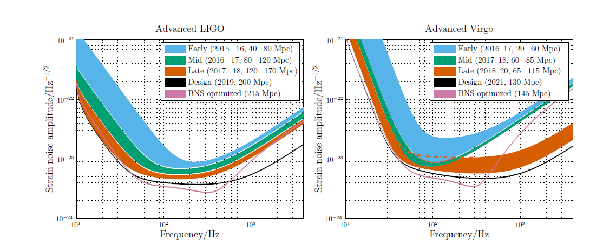
Mid term plans for LIGO-Virgo surveys
O1
O2
O3
Design sensitivity:
1000x gain in surveyed volume of the Universe
estimated BNS detection rate: 0.4-400/year
sky position error ~5 deg²
Performances upgraded in steps, interleaved by scientific observation runs:
Details in (arXiv: 1304.0670v2 gr-qc)

Slide 27
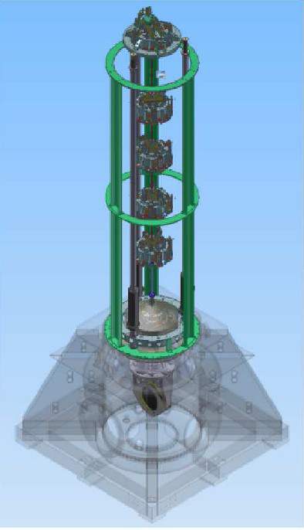


Advanced Virgo
one 3 km-long cavity is locked and under test
completing integration of the last 2 mirrors
commissioning of full interferometer from July
aiming to join O2 by end of 2016, as soon as the sensitivity gets interesting (“early” phase)
_ 3 km
_ 3 km

Slide 28
Benefits of a 3 detectors network
Detection confidence is greatly improved: lower background and higher SNR
Better coverage of sky and GW polarizations: better waveform reconstruction
LIGO H1+LIGO L1
LIGO H1+LIGO L1+ Virgo

Slide 29




Benefits of a 3 detectors network
sky localization greatly improved
Example based on GW150914
L1H1: 600 deg²
L1H1V1: ≈20 deg²
Expected reduction by a factor $\sim$30 in 90% probability area
5 detectors
3 detectors
2 detectors
triangulation helps,
in addition we use consistency in amplitude sensitivities
increase of the time coverage of the survey by detector pairs

Slide 30



2019+ scenario
Light travel times [ms]
Two more interferometers will join LIGO and Virgo:
KAGRA (Japan, 2019) and LIGO India (approved on February 2016)
Sky coverage of the whole observatory

Slide 31
observable volume of universe
Average Horizon distance and commoving volume for equal mass Binary BH mergers in planned LIGO-Virgo observations

Slide 32
from stellar mass BH to NS coalescences
BHs are the simplest GR objects
parametrized and accurate template banks has been calibrated against many Numerical Relativity simulations.
matched filtering techniques for detection and parameter estimation
inspiral phase provide best tests of GR
ring-down of remnant is best footprint of event horizon
detectors have top spectral performances at merger frequencies of stellar mass BH binary
best Signal-to-Noise Ratio
NSs include a lot more physics
templates describe inspiral phase
matched filter for detection of inspiral
merger waveform catalogs by Numerical Relativity simulations explore the parameters space.
measurement of merger waveforms need to be more general
late inspiral orbits are affected by NS tidal deformations
merger and post-merger are best footprints of NS Equations of State
detectors have worse spectral performance at merger and post merger of NS coalescences
disfavours measurement of merger and post-merger characteristics

Slide 33
final remarks
Advanced LIGOs first observation campaign has been completed, Sept. 12-2015 – Jan. 19 2016
Expect to see the complete results very soon !
Advanced Virgo will start commissioning of full interferometer in July.
the upcoming network will cover both GW polarizations for half of the sky.
Advanced interferometers will improve sensitivity by a factor 3 in a 3-5 years time-scale.
Current technologies and facilities could allow a further improvement in sensitivity by a factor 2
New facilities and significant technology development will be required for additional improvements
Binary NS will likely be detected in the next few years, but likely limited to the inspiral part

Slide 34
Inspiral of NS-NS or NS-BH binaries
NS Equation of State affects inspiral phase through tidal interactions
ongoing development of robust theoretical models in the Effective One Body formalism, including:
adiabatic NS tides (i.e. hydrostatic), multipoles corrections
see e.g. Bernuzzi et al., PRL 114, 161103 (2015)
dynamical NS tides (i.e. normal mode dynamics), fundamental quadrupole contribution
Hinderer et al., PRL 116, 181101 (2016)
Main parameters are NS tidal deformability constants (Love numbers) and eigenfrequency of fundamental quadrupolar mode.
testing models against Numerical Relativity simulations.
Next steps:
construction of template banks for parameter estimation of NS-BH and NS-NS inspirals
check performances as parameter estimation method

Slide 35


merger and post-merger of NS-NS
arXiv:1604.03445
NR group at Trento
h at 100 Mpc
Full GR MHD
Simulations
APR4 EoS
f [kHz]
Prompt collapse to BH
1.43+1.43 $M_{⨀}$
no detectable post-merger by LIGO-Virgo
Supramassive NS remnants
richest messengers of NS properties
1.22+1.22 $M_{⨀}$ 1.29+1.42 $M_{⨀}$
Signal-to-Noise Ratio of post-merger in LIGO-Virgo is a small fraction of the total (< 10%)

Slide 36

post-merger signals from NS remnants
Large variability of time-frequency features
Frequencies of main spectral features correlate with NS properties
quadrupolar tidal deformability, compactness and mass ratios of progenitors
Warning: interpretation/understanding of NR simulations is still not “universally” shared
Rezzolla & Takami arXiv:1604.00246
Bauswein & Stergioulas
main peak
type I: higher mass, softer EoS
type II:
intermediate
type III: lower mass, stiffer EoS
Tidal deformability
also PRD 91, 064001 (2015)

Slide 37


post-merger signals from NS remnants
Clark et al., CQG 33 (2016) 085003
type III: stiffer EoS TM1
type I: softer EoS SFHO
Detectability of post-merger
zero order estimate
 | Horizon | Rate
Adv LIGO | 30 Mpc | 1/century
LIGO A+ | 80 Mpc | 13/century
LIGO V | 140 Mpc | 41/century
see also Clark et al, PRD 90, 062004 (2014)

Slide 38
work in progress at Padova-Trento
Virgo data analysis group:
improve capabilities of waveform reconstruction by the reference pipeline LIGO-Virgo to detect generic transient signals
Numerical Relativity group (PI Giacomazzo)
Full GR MagnetoHydroDynamic simulation to deepen understanding of NS sources and extend exploration of emitted gravitational waves
improving methods to detect merger and post-merger features and to infer NS properties
hierarchical analysis scheme:
1. discrimination with controlled false alarm probability of
NS post-merger candidates versus null hypothesis
e.g. prompt collapse to BH
2. follow-up estimation of waveform parameters related to EoS
nothing detectable in LIGO-Virgo band
Notes:
Frequenza della isco, e dall’analisi dell inspiral abbiamo l e ocmponenti delle masse
M
Studio dlela rho dopo il merge (alto SNR)
Merger spectrum (FFT)

Slide 39




waveform reconstruction
Signal description
Numerical Relativity waveform courtesy of L. Baiotti and B. Giacomazzo.
Merger phase
BH formation
Binary NS-NS system: ~2.6 M
Post-merger phase
It produces a NS that survives for 0.1 s before collapse to BH.
L1-Injected Signal Time Frequency Map, dt~3.09 ms, df~128 Hz
L1-Reconstructed Signal Time Frequency Map, dt~3.09 ms, df~128 Hz
Injected Signal
SNR ~ 39
Reconstructed Signal
SNR ~ 40.5
Post-merger phase
Merger phase
Last orbits
Total Network SNR~ 72, hrss~6x10⁻²²
(D_{source} ~ 8 Mpc)
Notes:
Il lavorospecifico e’ sulla stima ,identificazione di pezzi di segnale.

Slide 40



post-merger phase
L1-TF Map, dt~7.81 ms, df~64 Hz
L1-TF Map, dt~7.81 ms, df~64 Hz
PRELIMINARY RESULTS
Injected Signal
SNR ~ 7.9
Reconstructed Signal
SNR ~ 7.5
Same sample event
Whitened data
Residual_frequency vs SNR
Studying the feature of the TF map in the post merger time frequency range (1600-4096 Hz) .
Monte Carlo study: software signal injections in Gaussian noise in the distance range 1-20 Mpc to measure the accuracy of post-merger reconstruction.
Livingston
Hanford
Virgo

Slide 41
final remarks
Advanced LIGOs first observation campaign has been completed, Sept. 12-2015 – Jan. 19 2016
Expect to see the complete results very soon !
Advanced Virgo will start commissioning of full interferometer in July.
the upcoming network will cover both GW polarizations for half of the sky.
Advanced interferometers will improve sensitivity by a factor 3 in a 3-5 years time-scale.
Current technologies and facilities could allow a further improvement in sensitivity by a factor 2
New facilities and significant technology development will be required for additional improvements
Binary NS will likely be detected in the next few years, but limited to the inspiral part
Matter effects in NS are much harder to be measured, first estimates give small rates, subject to large uncertainties. More developments and checks must still be pursued to establish expectations.

Slide 43



numerical relativity of binary neutron stars
BH formation
The coalescence of NS binary systems brings much physical properties.
Inspiral phase
Merger phase
Post-merger phase
EoS and astrophysical parameter (e. i. mass) leave their prints in merger and post-merger phase.
We are analyzing a catalog which collects BNS waveforms simulated by Trento and GeorgiaTech Numerical Relativity groups.

Slide 44
generic transient signal searches
Robust search strategy: coherent network data analysis
is mandatory to separate
  e.g. a likelihood Λ maximization of signal model vs noise model
  gives
  max{ ln(Λ) } = coherent energy + incoherent energy
  coherent energy in different detectors (consistent with a GW excitation)
GW parameter space (2 polarizations)
  incoherent energy (estimate of independent noises of detectors)
Null space
  cross detectors terms
  single detector terms
these methods can recover the entire Signal-to-Noise Ratio of the signal, but their background is polluted by non Gaussian outliers and need more effort to demonstrate highest significance wrt matched filtering techniques

Slide 45


Sources of Gravitational Waves
mass-Dipole Moment, [M R], is proportional to the position of the Center of Mass of the system:
      forbidden dipolar emission of GWs from isolated systems
leading order emission is mass-Quadrupole Moment $Q_{μν }$ , [M R²] :
  GW Luminosity is driven by ${\overset{⃛}{Q}}_{μν}≠0$
$$P≈\frac{G}{5c^{5}}{\overset{⃛}{Q}}_{μν}{\overset{⃛}{Q}}^{μν}\sim {10}^{39}W {\begin{aligned}\left(\frac{f}{Hz}\right) \\ \end{aligned}}^{2}{\left(\frac{M}{M_{⨀}}\right)}^{2} {\left(\frac{v}{c}\right)}^{4}$$
dimensional
argument
most promising sources: binary compact systems of Neutron Stars and Black Holes at relativistic speed
generating detectable GWs as in Hertz-like experiment is not feasible

Slide 46




continuos wave signals
The expected gravitational radiation amplitude depends on frequency ν, distance r, moment of inertia I, ellipticity ε
Taking non zero ellipticity
The signal emitted by a spinnign NS is nearly monocromatic, with a frequency slowly varying in time.
two polarization amplitudes
The spinning NS emits GWs as twice its rotational frequency
i inclination angle between rotation axis and line of sight
ν_{GW} = 2 ν_{rot}
Notes:
-hierarchical procedure-> coherent integration time in which a candidate event (parameter space point) is statistically significant.
further follow-up of candidate in order to establish is it is a signal or noise
fluctuations.

Slide 47






GWs from compact binary coalescences
Coalescences of Binary Black Holes as GW150914 give the simplest signal in GR
$$×10^{−21}$$
$$h$$
Inspiral phase: GW emission described by quadrupole formula. Analytical solution available.
GW standard candle.
Merger:
only numerical solution available.
Ringdown:
perturbative and numerical solutions
general relativity in strong field highly non-linear regime
NS would bring more physics
(Equation of State, ...)
Last inspiraling cycles enter the bandwidth of earth-based detectors.

Slide 48

PSR1916+13 versus GW150914
Waveform
Hulse-Taylor: 30 years of observation time
GW150914: 0.2 s

Slide 49


Quantum noise in detectors
High power operation is one of the most critical issues of the Advanced detectors
$$∝1/\sqrt{P}$$
Quantum noise
(shot) dominated
Next steps increase the detector input power up to 200 W (125 W for Virgo).
This means 500 kW of in cavity power.
Problems could arrise from photo-thermal effects (thermal lensing and nonequilibrium thermal noise) and dynamical instabilities
Is there an alterative to the high power?

Slide 50
Outlook 2020’s
Frequency dependent squeezing
whole band 2x gain in sensitivity, 8x in visible volume
Incremental upgrades of current Michelson infrastructures
    larger & more massive optics (LIGO A+)
        additional 2x gain in sensitivity
    add cryogenics (LIGO Voyager)
        additional 2x gain in sensitivity
from LSC
Whitepaper
2015

Slide 51


Outlook 2030’s
Underground infrastructures for ≥ 10km arms:
Einstein Telescope, Cosmic Explorer
extend the sensitivity band to larger mass BHs at low frequency and to NS at high frequency

Slide 52

Einstein Telescope
Frequenza (Hz)

