Slide 1
The magic of nuclear physics in particle therapy
Chiara La Tessa

Slide 2
Radiotherapy
To use radiation for killing tumor cells while minimizing the damage (and thus side effects) to the healthy tissue
Also called “Radiation Therapy”
Part of multi-disciplinary approach to cancer care
Useful for 50-60% of all cancer patients
Can be given for cure or palliation
Mainly used for loco-regional treatment
Benefits and side-effects are usually limited to the area(s) being treated

Slide 3
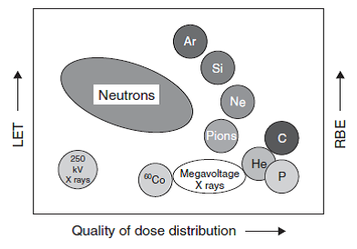
Radiotherapy
Today up to 60% of all cancer patients undergo radiotherapy as part of the treatment
Several types of charged and neutral radiation have been tested in the past 70 years.
X-rays are by far the most widely used beam but the application of charged particles has gained popularity.
Currently, protons and carbon ions are used.

Slide 5
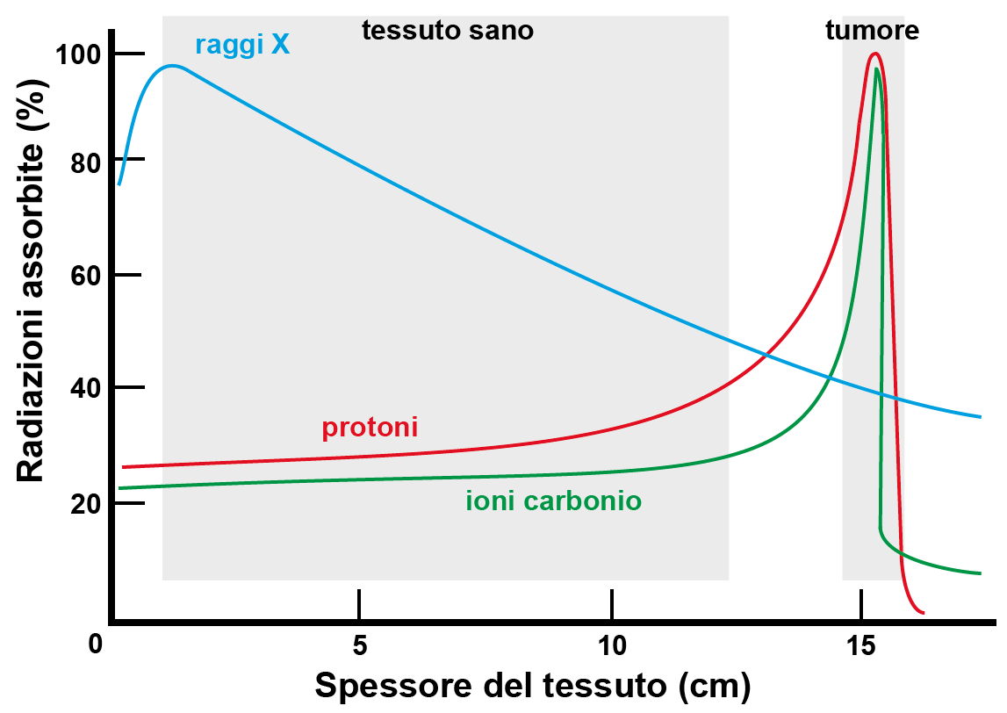
Physics:
Photons vs Ions
Bragg peak
The position can be varied by changing the beam energy.
The width depends on the ion type and energy but it is in the order of some mm.

Slide 6
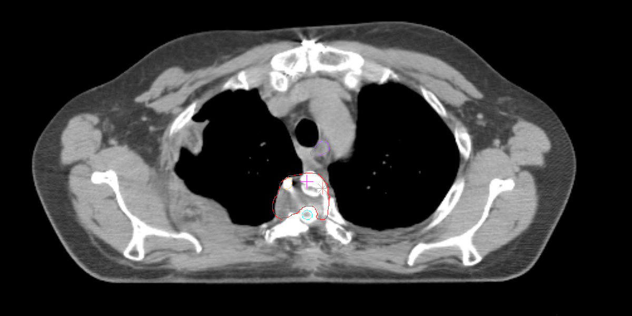
Dose localization
Dose deposited by photons
in the healthy tissue
Dose
Photons
Beam
Ions
Tumor
Ideal
Depth

Slide 7
Dose deposited by Protons and Photons inside the body during the treatment of a medulloblastoma (brain tumor).
Charged particles are more effective in sparing the healthy tissue.
Protons
Photons
Difference

Slide 8
From physics to the clinic
Using a monoenergetic beam, we can irradiate a region whose size is approximately that of a 1 cent coin.
Tumors size covers a relatively broad range but often it is in the order of cm³.
We need to find a way to “transform” our 1 cent coin into a golf ball.

Slide 9
Let’s start from the depth
- As we said earlier, the Bragg peak depth depends on the beam energy.
- The higher is the energy the deeper is the Bragg peak position.
- Using several monoenergertic beams, we can covert the tumor “length”.
Ions
Photons

Slide 10
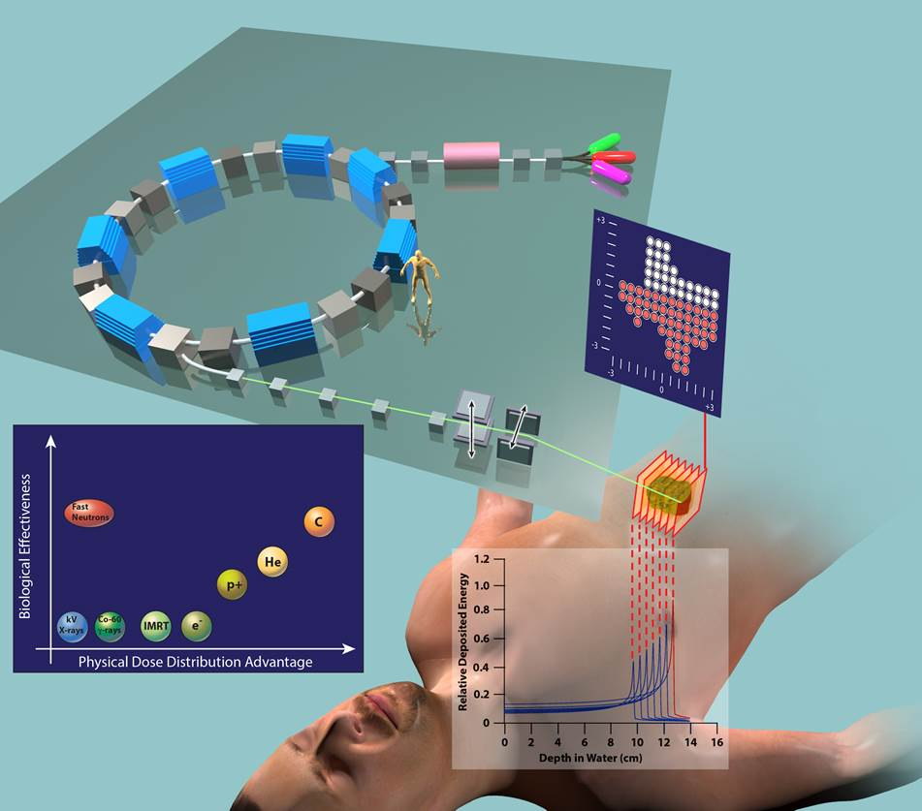
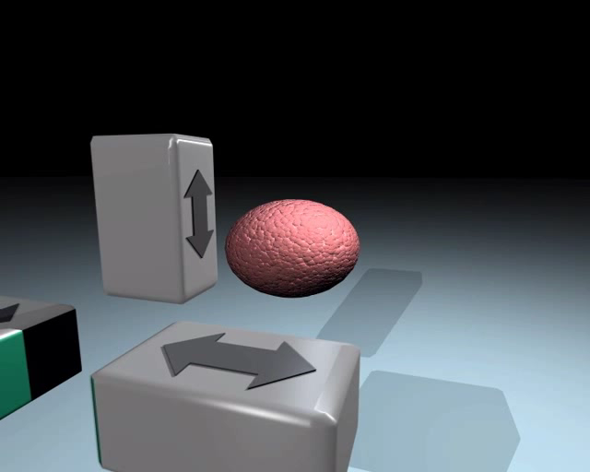
Cyclotrons or synchrotrons to reach the desired energy
(up to 230 MeV for protons and 450 MeV/u for carbon)
Ion source
Magnets
(Gantry)
Treatment planning system

Slide 12
Which are the most important physical processes in radiotherapy?
Energy loss (electromagnetic)
Multiple Coulomb scattering (electromagnetic)
Nuclear fragmentation
These process can occur:
In the elements along the beam line (range shifter, collimator…)
In the patient’s body
And they can all influence the dose delivered by radiation and thus its biological effect.

Slide 13
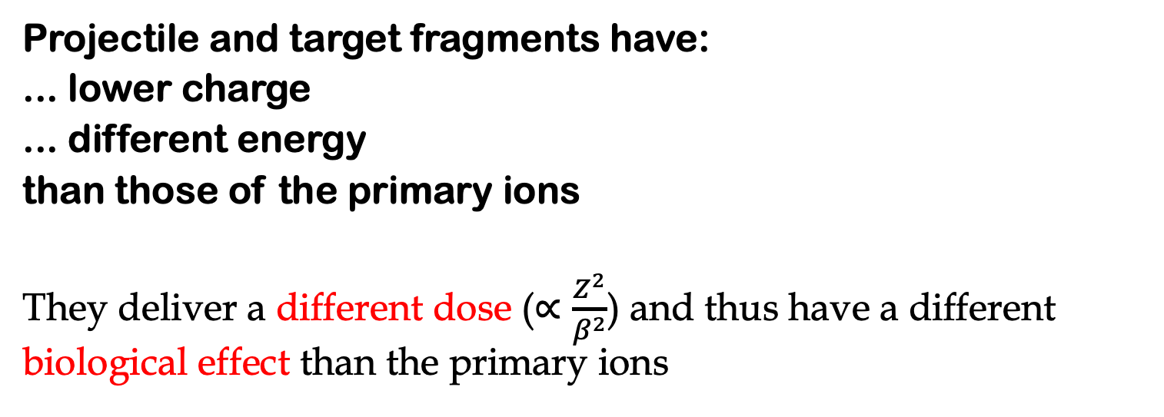
Nuclear fragmentation
projectile fragments
projectile
target
target fragments
Projectile and target fragments have:
... lower charge
... different energy
than those of the primary ions
They deliver a different dose ($∝\frac{Z^{2}}{β^{2}}$) and thus have a different biological effect than the primary ions

Slide 14
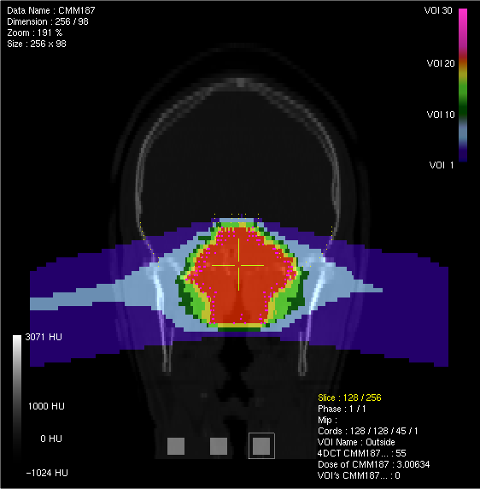
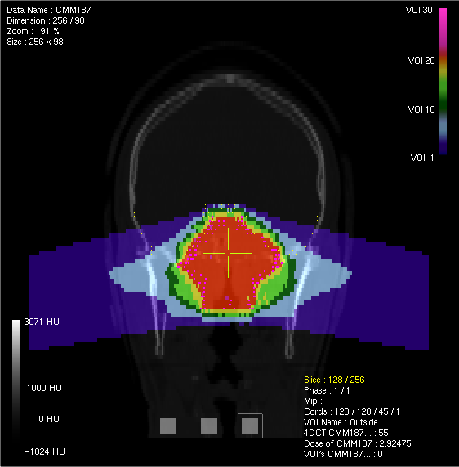
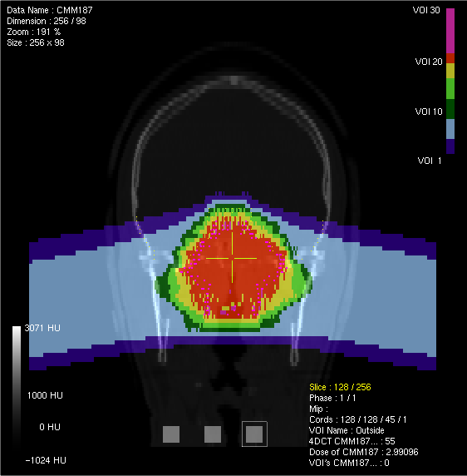
Effects of nuclear fragmentation in particle therapy
12C
4He
1H
(3)
(2)
(4)
(1)
Deposition of dose in the following regions outside the tumor:
Entrance channel
Lateral margins
Lateral distances
Tail

Slide 15
Some physics challenges in ion therapy
Reduction of range uncertainty (tracking, online monitoring, proton radiography)
Beam delivery technologies (including 4D/5D optimization) to broaden the diseases elected to be treated with particles is very important to reduce the cost/benefit ratio of the facility
New ions can be used for pediatrics (⁴He) or vey hypoxic tumors in single-fractions (¹⁶O)
Verification and optimization of Treatment Planning Systems (TPS), including extension to Monte Carlo codes

Slide 16
Exploiting nuclear fragmentation

Slide 17
Ions in a human body
The interaction of the primary beam with our body creates tons of charged and neutral fragments emitted at several energies and angles
p
alpha
n
ɣ
ɣ
Patient
n
Ion beam
Tumor
ɣ
p
The interaction probability increases with:
Depth
Decreasing energy of the primary
Thus, the highest yield is detected around the Bragg peak

Slide 18
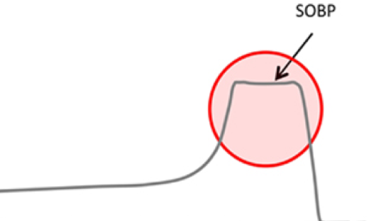
Monitoring the PTV and tumor position during the treatment…a tricky business
Some smart physicists thought of exploiting the production of secondary particles to get information on the position of the irradiated volume:
Positron Emission Tomography (PET)
Prompt Gammas (PG)
Charged particles
…and even neutrons
Planned Target Volume (PTV)
Each method has some cons:
Limited spatial resolution
Low statistics for the events of interest in a typical TP
Detection limitations
None of these methods can give an indication of the tumor position with respect to the SOBP.

Slide 19
A different approach
What if the tumor could be loaded with a “magic element” that not only enhances the production of PG but also emits a signature spectrum?
ɣ
ɣ
ɣ
Ion beam
Tumor
+
Magic Element

Slide 20
Requirements for the magic element
Production of high energetic PGs (to increase detection probability)
Production of a signature spectrum (different from the background spectrum)
High selectivity (maximize the concentration inside the tumor while minimizing the absorption into the normal tissue)
Non toxic
Note: PG are produced from fragmentation and proton capture…we are more interested in proton capture because it gives signature energies

Slide 21

And the magic element is…
Drum Roll…

Slide 22
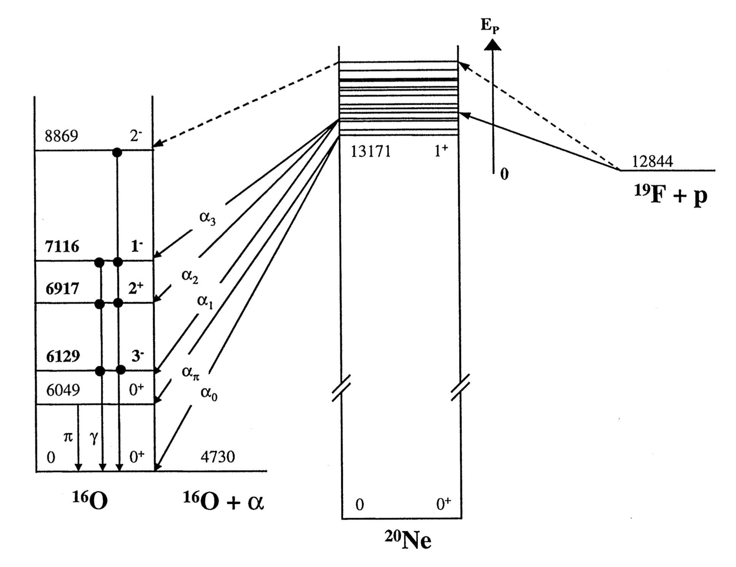
19 FLUORINE 19F(p,γ)16O
HIGH-ENERGY PG
CARRIER (18F-FDG)
PRODUCTION OF 16O
63 COPPER
63Cu(p,γ)
HIGH-ENERGY PG
CARRIER (CU-ATSM)
90 YTTRIUM
90Y(p,γ)
HIGH-ENERGY PG
CARRIER (ANTIBODY)

Slide 23
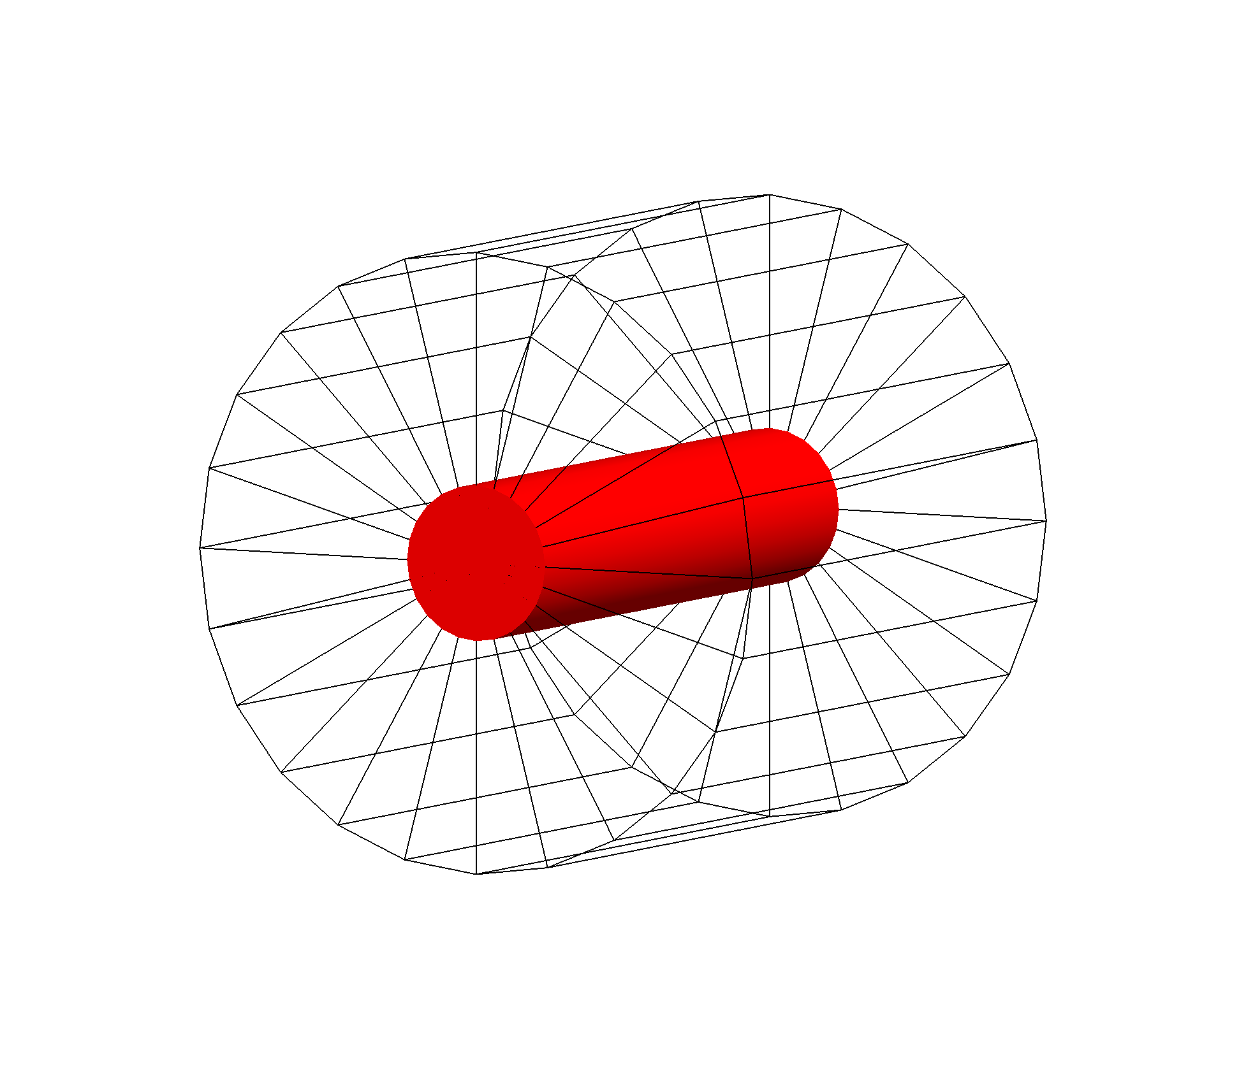
Monte Carlo Simulation (GEANT4)
Tumor made of:
Tissue-equivalent (to estimate the background)
19F
63Cu
90Y
Tissue-equivalent
10 cm
Tumor
Tissue equivalent
2.5 cm
20 MeV
proton beam
10 cm
10 cm
Tumor made 100% of the element. Selectivity and maximum achievable concentration are being investigated.

Slide 24
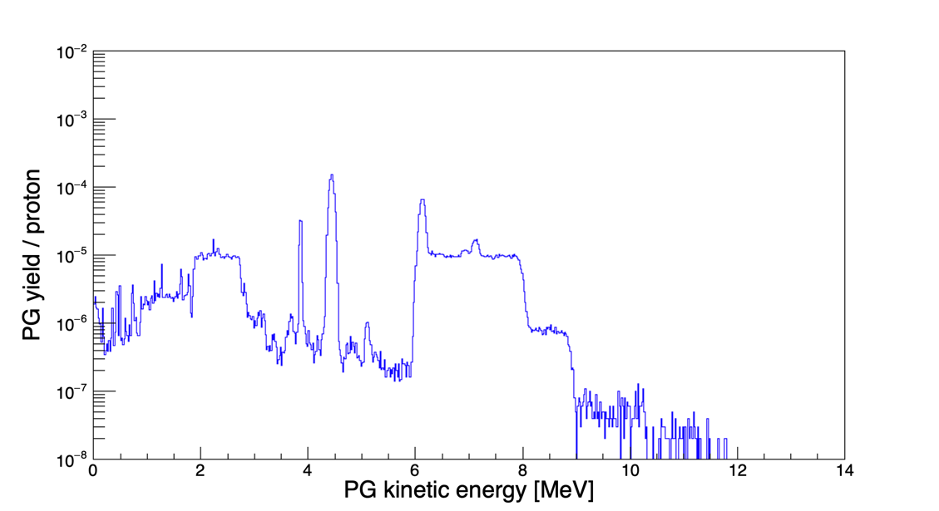
Prompt Gammas (PG) exiting the tumor
12C
16O
Tissue-equivalent (TE)
15O

Slide 25
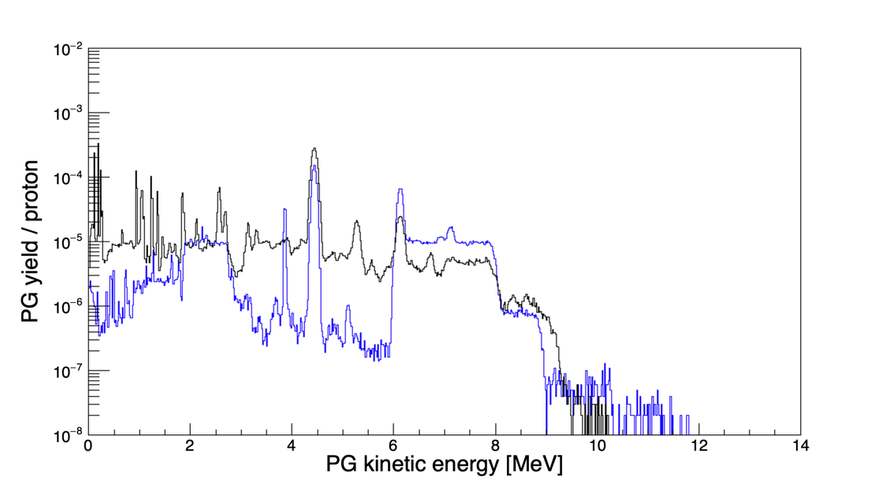
Prompt Gammas (PG) exiting the tumor
12C
16O
15O
TE
19F

Slide 26
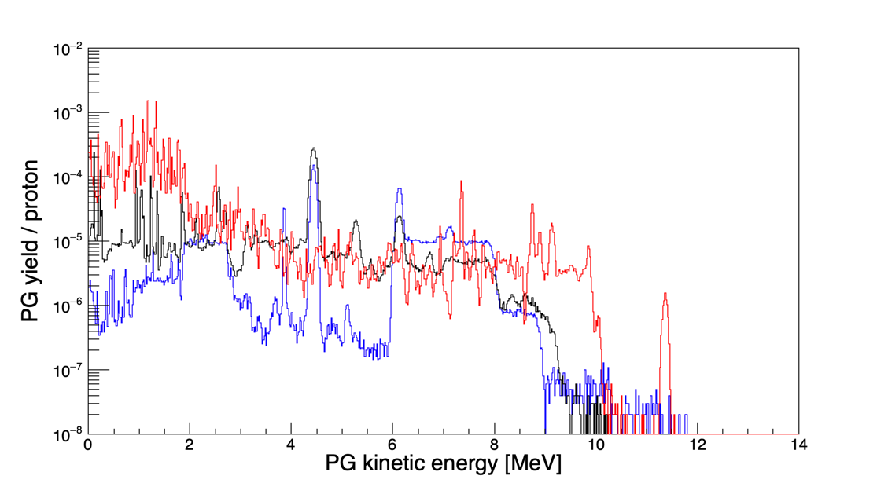
Prompt Gammas (PG) exiting the tumor
12C
16O
15O
TE
19F
63Cu

Slide 27
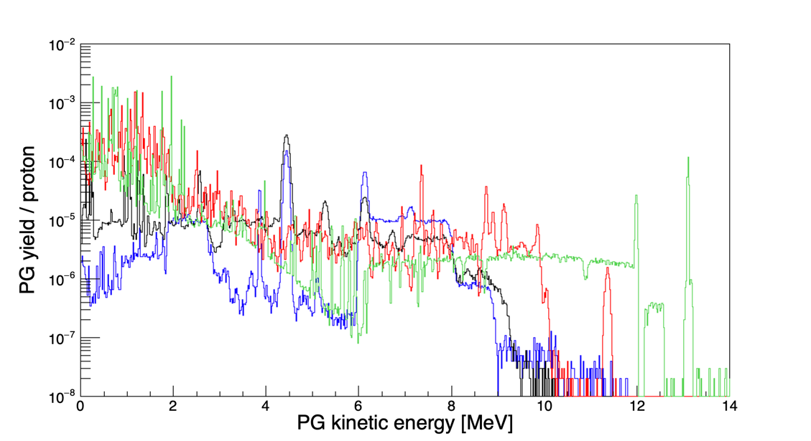
Prompt Gammas (PG) exiting the tumor
12C
16O
TE
19F
63Cu
90Y
15O

Slide 28
Summary
Facts:
Charged particles are a powerful tool against cancer
Nuclear processes (and in particular nuclear fragmentation) strongly influence the radiation biological effect
Take home messages:
It is possible to load the tumor with a “magic element” to create a detectable signature of gammas
The signature gives information about tumor location with respect to the PTV
Additional experiments are required to obtain PG production libraries for GEANT4
This method provides real-time TP verification (position of the tumor and PTV)

Slide 29
+ people from UNITN, CIBIO and FBK
+ people from other universities, INFN sections and labs in Italy
+ people from research facilities and institutes around the world

Slide 30
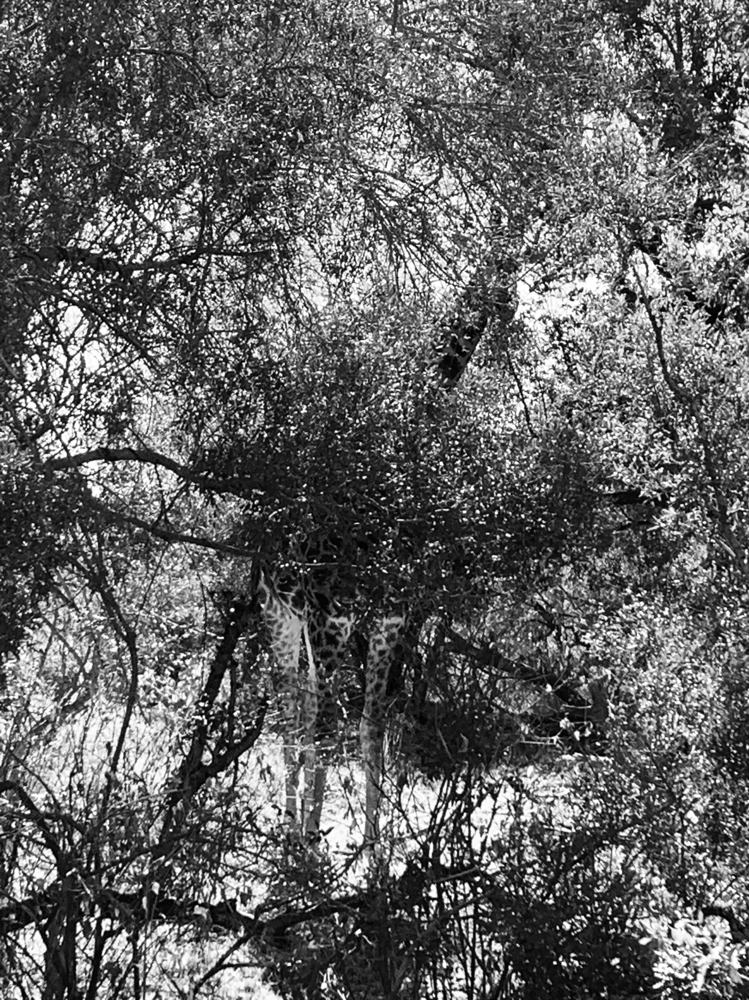
Thank you for your attention.
Questions?

