Slide 1

Positronium production and laser excitation
for antimatter experiments
Sebastiano Mariazzi on the behalf of:
Antimatter Lab
Ruggero Caravita
Luca Povolo
Luca Penasa
Marco Bettonte
Roberto S. Brusa

Slide 2
Overview:
1. Introduction: motivation of antimatter studies and Positronium (Ps)
2. Ps for Antihydrogen production (AEgIS)
3. Production of a metastable Ps beam
4. Perspectives

Slide 3
Overview:
1. Introduction: motivation of antimatter studies and Positronium (Ps)
2. Ps for Antihydrogen production (AEgIS)
3. Production of a metastable Ps beam
4. Perspectives

Slide 4
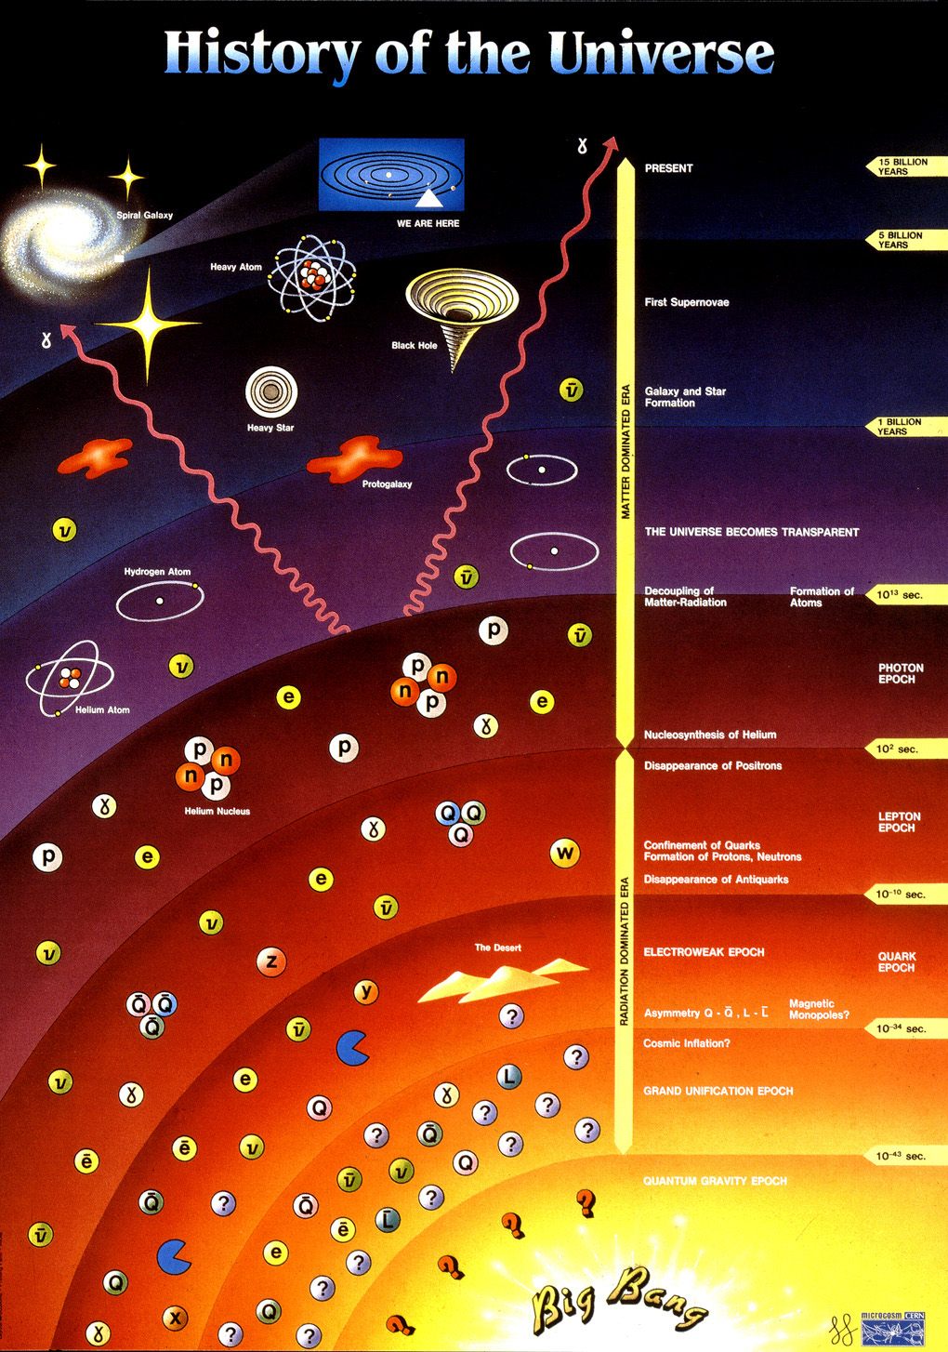
Introduction: matter/antimatter asymmetry
Imbalance in matter and antimatter in the observable universe
The disappearance of anti matter is not understood neither from theory or experiment
Violation of
CPT?
Weak equivalence principle (WEP)?

Slide 5
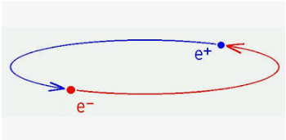
Introduction: Positronium (Ps)-intrinsic properties
First experimental observation:
M. Deutsch, Phys. Rev. 82, 455 (1951)
Ground state: 1³S
Ground state: 1¹S
ortho-positronium (o-Ps)
para-positronium (p-Ps)
Lifetime: 142 ns
Lifetime: 125 ps

Slide 6

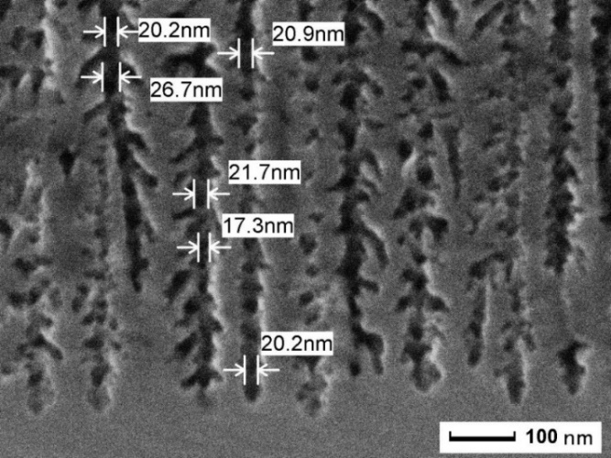
Introduction: Positronium (Ps) production
Ps can be formed by injecting positrons in nanostructured insulators.
e+/Ps converter
Electrochemical etching of Si p-type.
Ps
Ps
SEM picture: section
Ps
Ps
Ps
Ps emission and cooling
e+/Ps conversion efficiency up to 50%
Mariazzi S., Brusa R S et al., Phys. Rev. B 81, 235418 (2010)

Slide 7
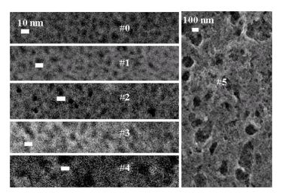
Positronium (Ps): extrinsic properties
Tuning of the nanochannel size from 4-7 nm up to 100 nm
Quantum confinement:
the nanochannel size determines the minimum Ps kinetic energy
Tuning of the size to tune the Ps kinetic energy
Production of Ps with v=10⁵ m/s or lower
SEM picture: surface
Mariazzi S., Salemi A, Brusa R S Phys. Rev. B 78, 085428 (2008)
Mariazzi S., Bettotti P., Brusa R S, Phys. Rev. Lett. 104, 243401 (2010)

Slide 8
Overview:
1. Introduction: motivation of antimatter studies and Positronium (Ps)
2. Ps for Antihydrogen production (AEgIS)
3. Production of a metastable Ps beam
4. Perspectives

Slide 9
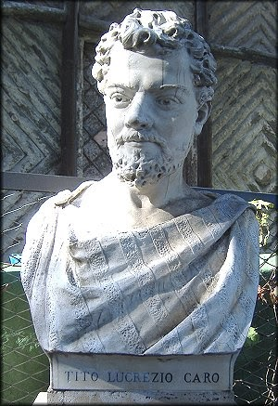
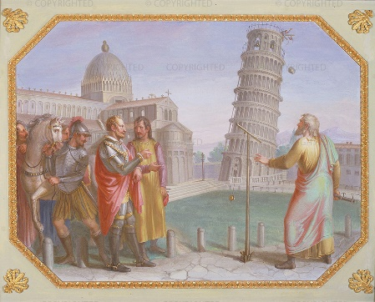
Ps for Antihydrogen production (AEgIS)
AEgIS: Antimatter Experiment: Gravity Interferometry Spectroscopy
Main scientific goal: test of weak equivalence principle with antihydrogen.
WEP for matter:
Hipparchus (200-120 a.C.) ?
“ ...omnia quapropter debent per inane quietum aeque ponderibus non aequis concita ferri”.
Lucretius Carus (90-55? a.C.)
Giovanni Filopono (490-570)
“In vacuo corpora eiusdem materiae aequali velocitate moventur”.
Giovanni Battista Benedetti (1530-1590)
“cascai in opinione che se si levasse totalmente la resistenza del mezzo, tutte le materie discenderebbero con eguali velocità”.
Galileo Galilei (1564-1642)

Slide 10
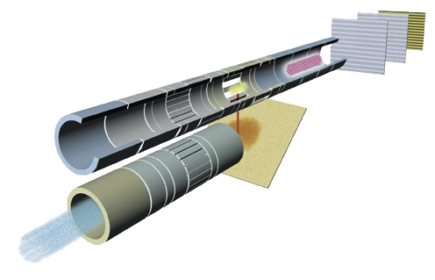
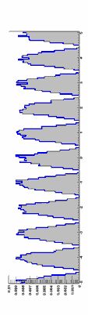
Ps for Antihydrogen production (AEgIS)
WEP for antimatter:
Antihydrogen beam production via charge-exchange reaction:
To maximize the cross section:
Cold Ps (10⁴-10⁵ m/s)
Ps in Rydberg states
positrons
e⁺/cold Ps converter
Laser for Ps excitation in Rydberg states
Antiprotons
Antihydrogen beam
Moirè deflectometer
Aghion et al. (AEgIS) Nature Comm. 5, 4538 (2014)

Slide 11
Ps for Antihydrogen production (AEgIS)
1.5x10¹³ p/bunch 26GeV/c
E= 5.3 MeV

Slide 12
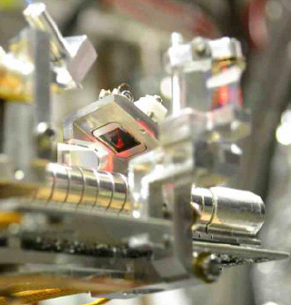
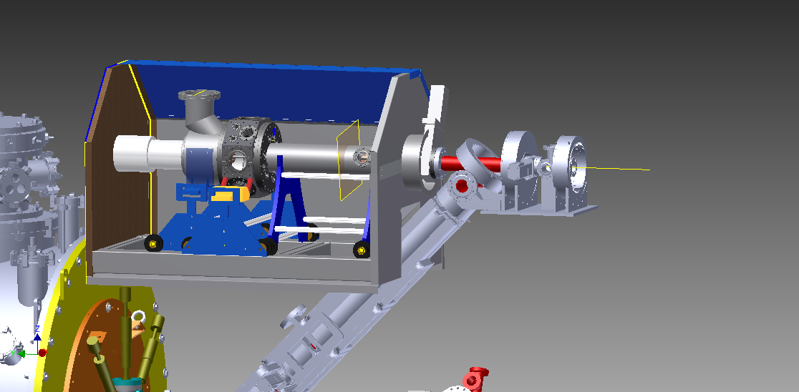
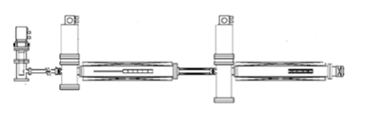
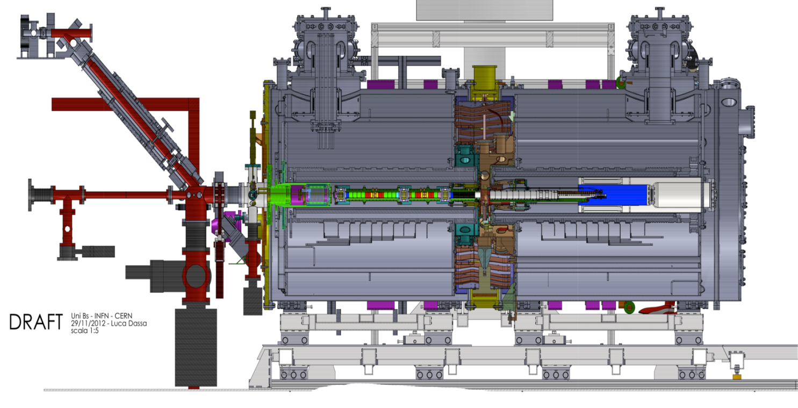
Ps for Antihydrogen production (AEgIS)
e+/Ps converter
Chamber for Ps
experiments
e+ bunched beam
positrons
5T trap
1T trap
Antiproton beam from AD

Slide 13

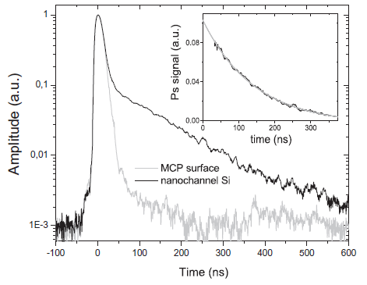
Ps for Antihydrogen production (AEgIS)
Single Shot Positron Annihilation Lifetime Spectroscopy (SSPALS)
PbWO₄ scintillator + PMT
Aghion S. et al. (AEgIS collaboration), NIMB 362, 86 (2015)

Slide 14
Ps for Antihydrogen production (AEgIS)
1³S→3³P→Rydberg
continuum
n=3
IR 1064 nm photoionization
n=2
UV 205 nm
n=1
S(%)=(Area laser OFF-Area laser ON)/Area laser OFF
Aghion S. et al. (AEgIS collaboration), Phys Rev A 94, 012507 (2016)

Slide 15
Ps for Antihydrogen production (AEgIS)
1³S→3³P→Rydberg
continuum
n=3
IR ~1700 nm
n=2
UV 205 nm
n=1
S(%)=(Area laser OFF-Area laser ON)/Area laser OFF
Aghion S. et al. (AEgIS collaboration), Phys Rev A 94, 012507 (2016)

Slide 16
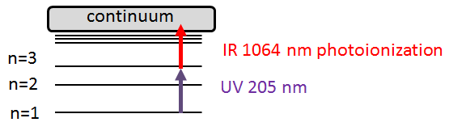
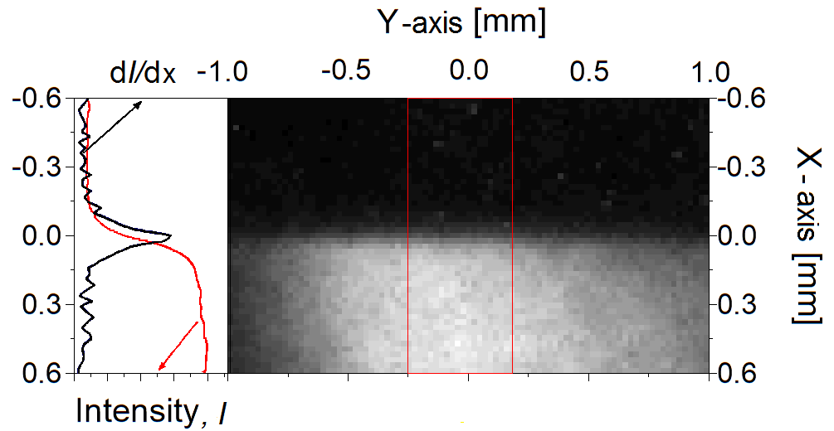
Ps for Antihydrogen production (AEgIS)
Ps imaging in 1 T
Spatial resolution: 88±5 μm
Aghion S. et al. (AEgIS collaboration), NIMB 15, 44 (2019)

Slide 17
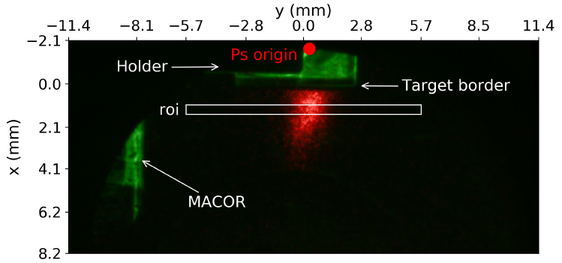
Ps for Antihydrogen production (AEgIS)
Ps imaging in 1 T
Monitor of:
-Ps emission from the e+/Ps converter
-Ps/laser synchronization
-Ps excitation to a selected state
-propagation of excited Ps
Aghion S. et al. (AEgIS collaboration), NIMB 15, 44 (2019)

Slide 18

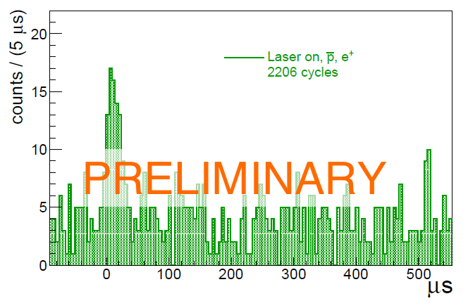
Ps for Antihydrogen production (AEgIS)
Antihydrogen production
UV 205nm +IR ~1700 nm
Ps*
antiprotons
scintillators
Consistent with 0.07 antihydrogen atoms per production cycle
Amsler C. et al. (AEgIS collaboration), Nature comm submitted

Slide 19
Overview:
1. Introduction: motivation of antimatter studies and Positronium (Ps)
2. Ps for Antihydrogen production (AEgIS)
3. Production of a metastable Ps beam
4. Perspectives

Slide 20
Production of a metastable Ps beam
2³S Ps production
Ps interesting for antihydrogen production for matter/antimatter symmetry tests
Can we directly use Ps for matter/antimatter symmetry tests?
Advantage: easier production with respect to antihydrogen
Disadvantage: very short lifetime in the ground state
No (ground state) Ps beam
2³S lifetime 1140 ns
205 nm

Slide 21
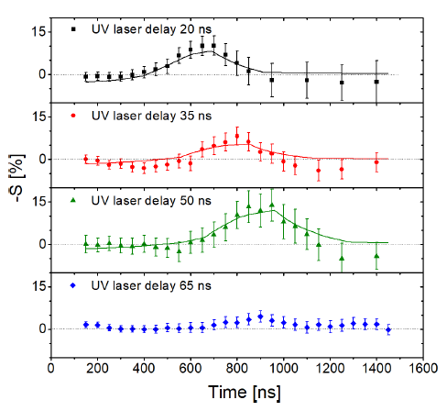
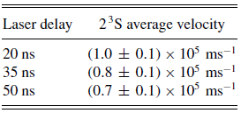
Production of a metastable Ps beam
2³S Ps production
205 nm
Aghion S. et al., (AEgIS collaboration) Phys. Rev. A 98, 013402 (2018)
Amsler C. et al., (AEgIS collaboration) Phys. Rev. A 99, 033405 (2019)

Slide 22
Production of a metastable Ps beam
2³S Ps stimulated production
Only 205 nm:
1³S→3³P ~15%
3³P→2³S ~10%
1³S→3³P→2³S ~1.5%
1312 nm
205 nm
205 nm + 1312 nm:
1³S→3³P→2³S ~1.5% x 3
Antonello M. et al., (AEgIS collaboration), Phys. Rev. A, 100, 063414 (2019)

Slide 23
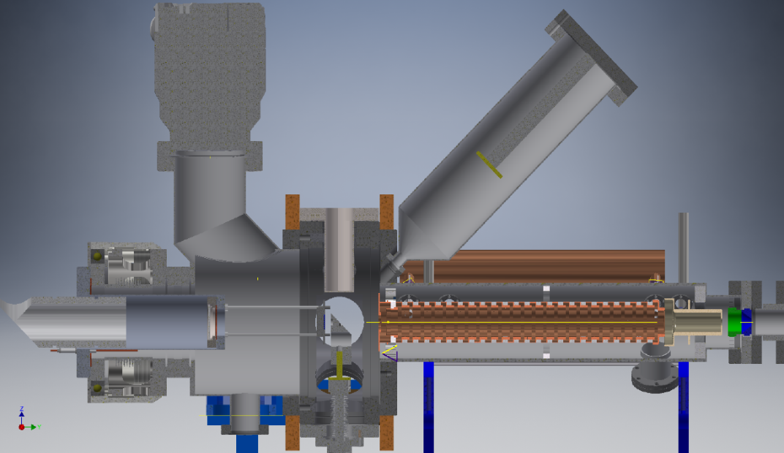
Production of a metastable Ps beam
LaBr3
30 cm
Pb
CF16
~17 msterad
Excess of events between 1500 and 2250 ns→(1.6 ± 0.4) 10⁵ m/s
Some 10⁻⁶ 2³S Ps per e⁺
Mariazzi S., Caravita R. et al., (AEgIS collaboration), Acta Phys Pol. A, 137, 91 (2020)

Slide 24
Overview:
1. Introduction: motivation of antimatter studies and Positronium (Ps)
2. Ps for Antihydrogen production (AEgIS)
3. Production of a metastable Ps beam
4. Perspectives

Slide 25
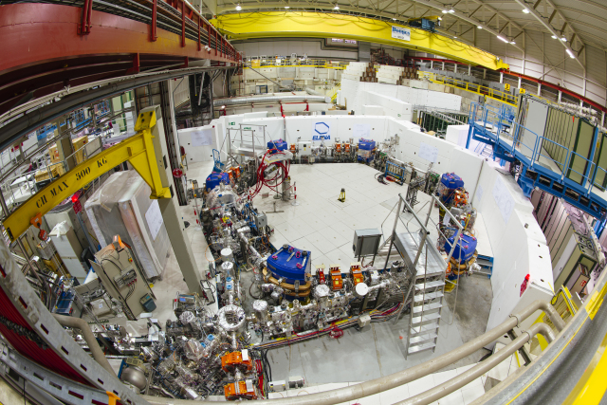
Perspectives about Antihydrogen production (AEgIS)
ELENA 2021→from 5.3 MeV to 100 keV
up to 30 times the number of antiprotons
Redesign of the geometry of the electrode and conversion target region to improve the Ps* antiprotons overlap and the cross section.
UV 205nm +IR ~1700 nm
Increase of the cross section up to 30 times
Ps*
antiprotons
From 0.07 antihydrogen atoms per production cycle up to 60 antihydrogen per production cycle
B

Slide 26
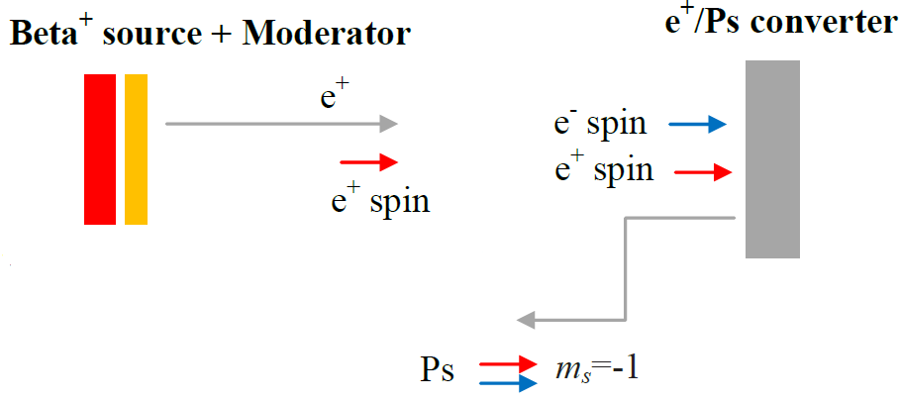
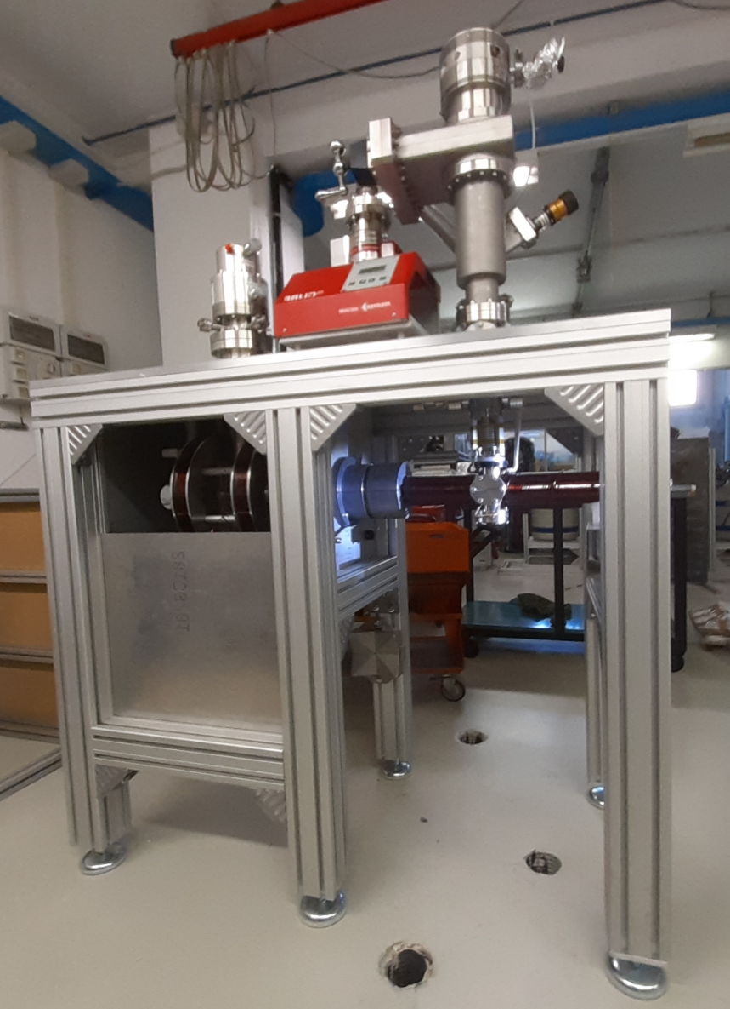
Perspectives about 2³S Ps beam
Production of spin polarized 2³S Ps
Under development in TN
Parity violation
e+
205 nm
1312 nm
²²Na

Slide 27
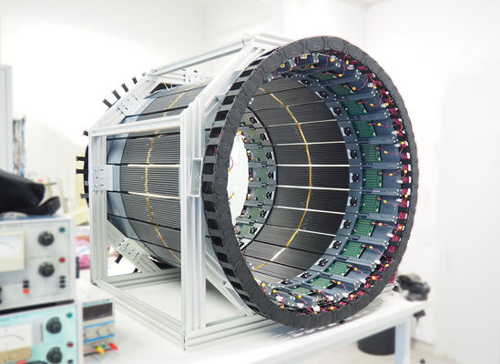
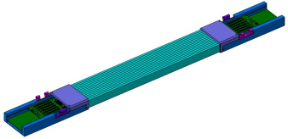
Perspectives about 2³S Ps beam
Study of the entaglement of 2³S Ps annihilation gamma rays
GOAL: determination of the polarization of the 3 gamma rays as a function of the initial Ps spin.
J-PET modules
t₁
t₂
Gamma ray
Hiesmayr B.C. and Moskal P. Sci. Rep. 7, 15349 (2017)
Moskal P. et al., Eur. Phys. J. C 78, 970 (2018)

Slide 28
Perspectives about 2³S Ps beam
Inertial sensing with 2³S Ps
-availability of a 2³S Ps beam with tunable velocity
-spatial sensitive detector with 88±5 μm
Force
Force
2³S source
Spatial sensitive detector
Fringe pattern
The current beam intensity and detector resolution are enough to measure a force of ~4 10 ⁻²² N
For smaller forces:
-improve of the detector spatial resolution detector (below a few μm)
-increase of the 2³S beam intensity
Mariazzi S., Caravita R., Brusa RS et al., Eur Phys J. D 74, 79 (2020)

Slide 29
Thank you for your attention
https://www.physics.unitn.it/en/481/antimatter
https://home.cern/science/experiments/aegis
http://aegis.web.cern.ch/doku.php

Slide 30
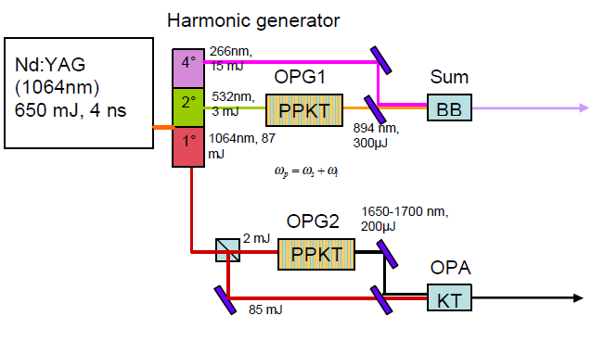
Ps excitation -laser system
Signal and Idler
OPA (Optical Parametric Amplifier) after the OPG to match in SUM
SUM in a BBO (Barium Borate)crystal
Wavelength tuned by changing the OPG temperature
Cialdi et al. NIMB 269, 1527 (2011), Castelli et al. PRB 78, 052512 (2008)

Slide 31
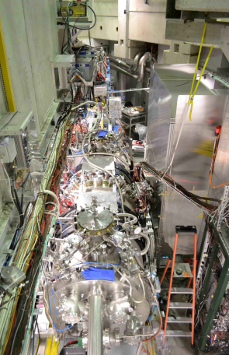
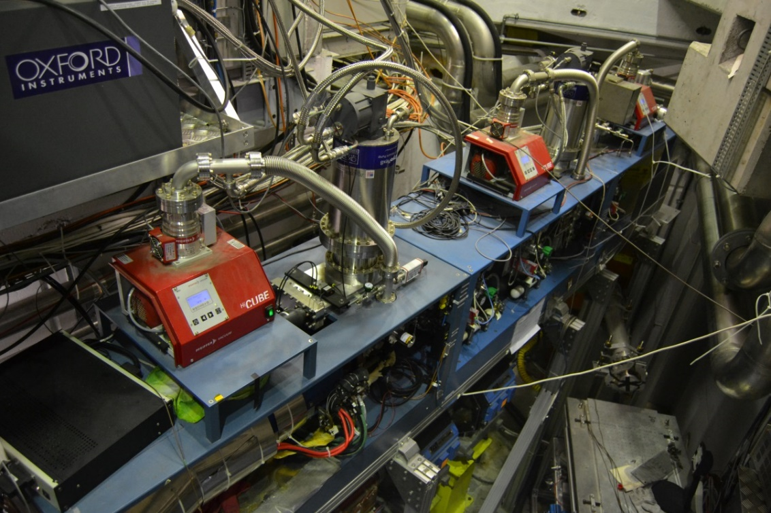
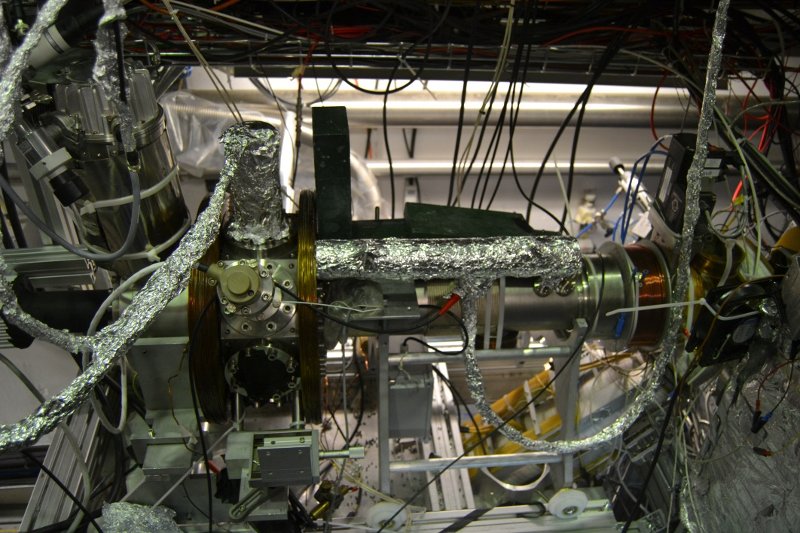
Surko trap+accumulator
AEgIS set-up
Chamber for Ps exp

Slide 32
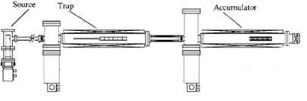

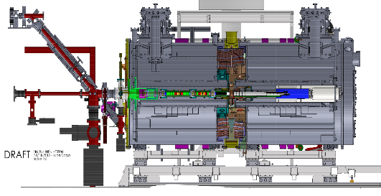
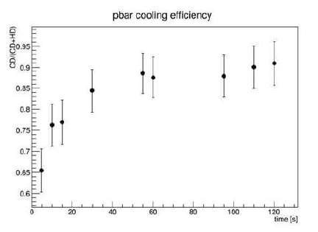
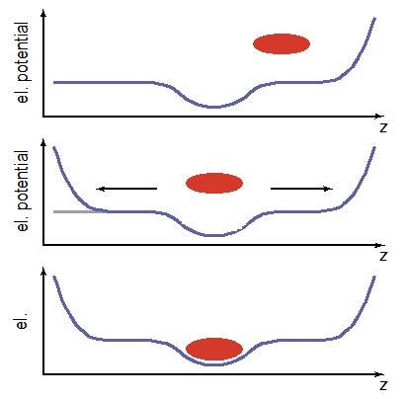

A$ntiproton trapping$
scintillators
~ 4x10⁵ pbar for shot
are captured
on 3x10⁷
(shot every 2 min)
90% of captured pbar
are cooled
hot dump
cold dump
Antiproton cold ejection /total p bar, as a function of time spent cooling with electrons.
Caravita R et al. WAG 2015

Slide 33
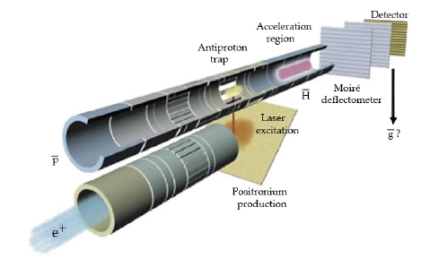
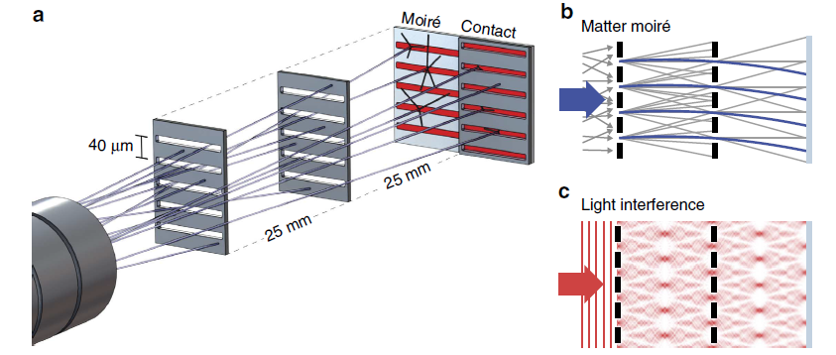

$$Test with mini−moiré$$
Antiproton E=100 keV
slit arrays in 100-μm thick silicon by ion etching
slit width of 12 μm
periodicity of d=40 μ m
Reference measurement with light (Talbot –Lau)
Aghion et al. (AEgIS) Nature Comm. 5, 4538 (2014)

Slide 34
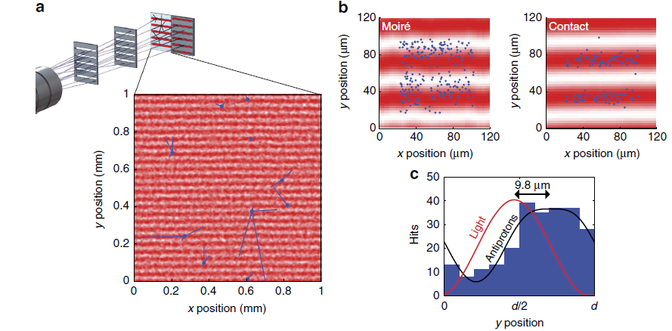
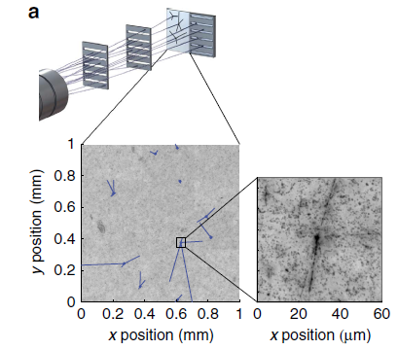
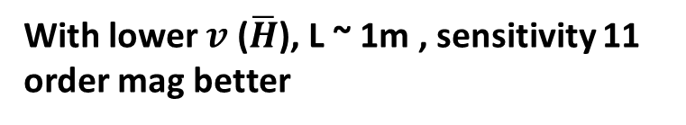
Δy=9.8±0.9 μm (stat.)
±6.4 μ m (syst.)
Compatible with a force
530 ±50 (stat.) ± 350 (syst.) aN
Corresponding to an E=33 V/cm direction of the grating period
or a B= 7.4G perpendicular to the grating period and antiproton direction
Emulsion
With lower $v$ ($\overline{H}$), L ~ 1m , sensitivity 11 order mag better
Aghion et al. (AEgIS) Nature Comm. 5, 4538 (2014)

Slide 35
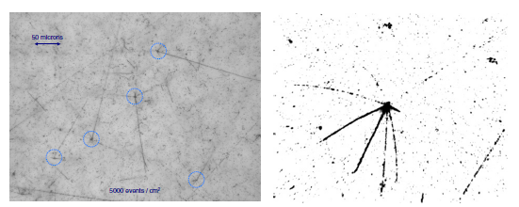
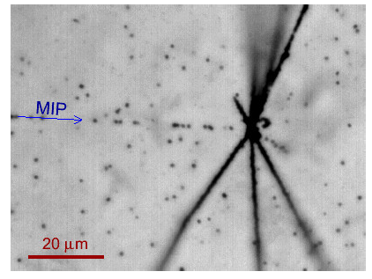
Detectors: emulsions
Antiprotons 100 keV
Annihilation vertex and tracks.
Positions are found with 1-2 μm
resolution
Tracks: pions, vertex proton and
Heavy nuclear fragments.
Storey et al. Hyp. Inter . 228, 151 (2014), S. Aghion et al. JINST 2013

Slide 36
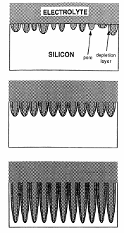

Positron/positronium converters
Electrochemical etching of Si p-type
resistivity 0.15-0.21 Ohm/cm
etching current 4-18 mA/cm² ,
etching time 10’-17’
subsequent nanochannel surface oxidation
SiO₂
Positron beam
Si
Ps
Advantages:
-high Ps formation and emission into the vacuum
-possibility to tune the nanochannel dimension (important for Ps cooling at low temperature)
Ps
Ps
Ps
Ps
Mariazzi S. et al., 2010 Phys. Rev. B 81, 235418

Slide 37
Ps production and cooling in
nano-channeled Si: quantum confinement
In nanochannels modeled as infinitive potential wells with a quadratic base of side a and infinite length along the direction perpendicular to the surface of the sample the Ps ground state is:
the minimum temperature is:
160 K
In #0 (4-7 nm) minimum T is 60-180 K,
in #1 (8-12 nm) minimum T is 20-45 K.
Mariazzi S. et al., 2008 Phys. Rev. B 78 085428
Crivelli et al., 2010 Phys. Rev. A 81 052703

Slide 38
Positron/positronium converters: TOF measurements
Ps Time of Flight (Ps-TOF)
Nanochannel size 5-8 nm
Two lines corresponding to two Maxwellian beams at two different temperatures.
Presence of a thermal fraction in the sample temperature range 150-300 K
Mariazzi S et al., 2010 Phys. Rev. Lett. 104, 243401

Slide 39
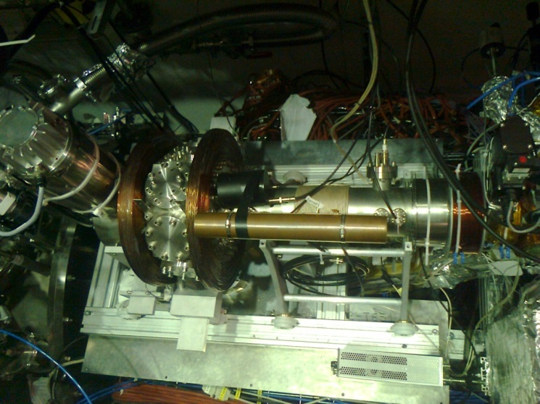
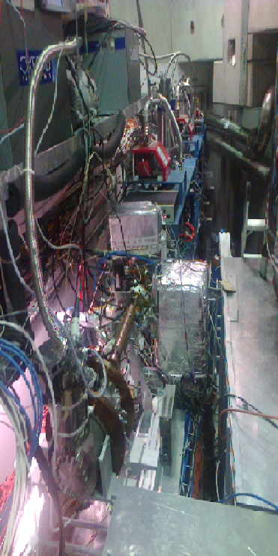
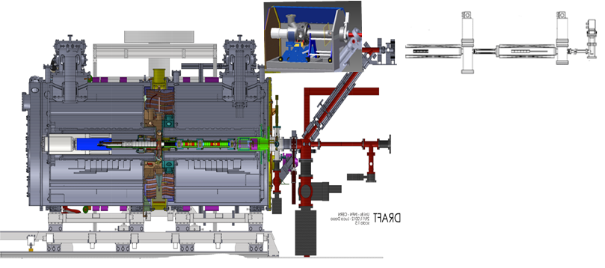
$$Positronium experimental chamber$$

Slide 40
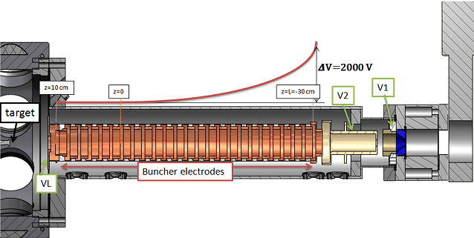
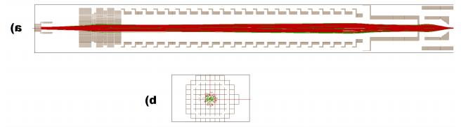
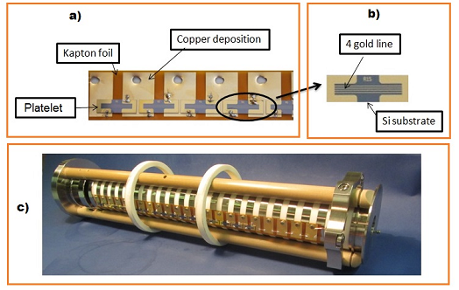
Positronium experimental chamber: e+ $rebunching system$
Di Noto L. PhD Thesis; SLOPOS 13

Slide 41
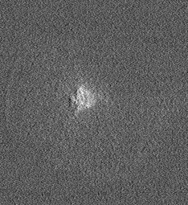
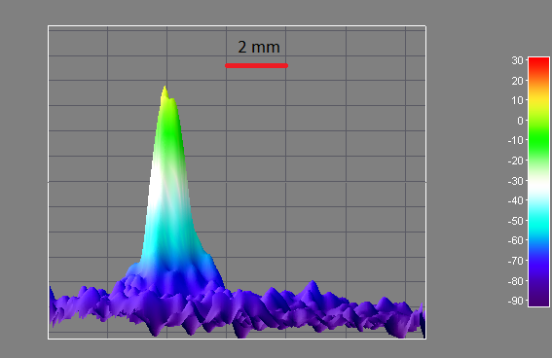
Positronium experimental chamber: performances
Na22 source
Ne moderator
20 ns
100 V
10^7-10^8 e+
6-7 ns
3-7 kV
10^7 e+
re bunching
2 stages
Surko trap
accumulator
Ps
Field
terminator
In magnetic field 700- 1000 G
Electrostatic and then Free field
at the e+ -Ps converter
Spot at MCP
Bunching (PbF₂+PMT)
Aghion et al. NIMB 362,86 (2015)

